Slide 1
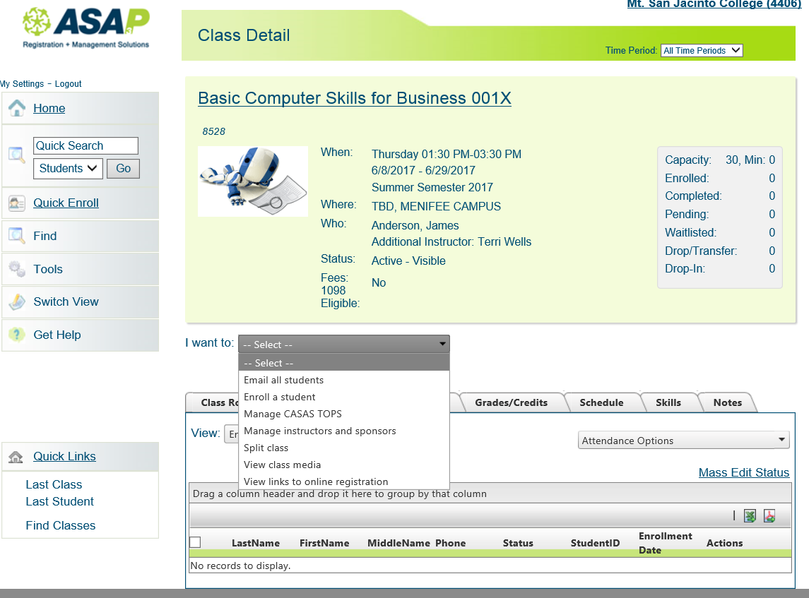
To Enroll Students
Click Drop down arrow select Enroll a Student

Slide 2
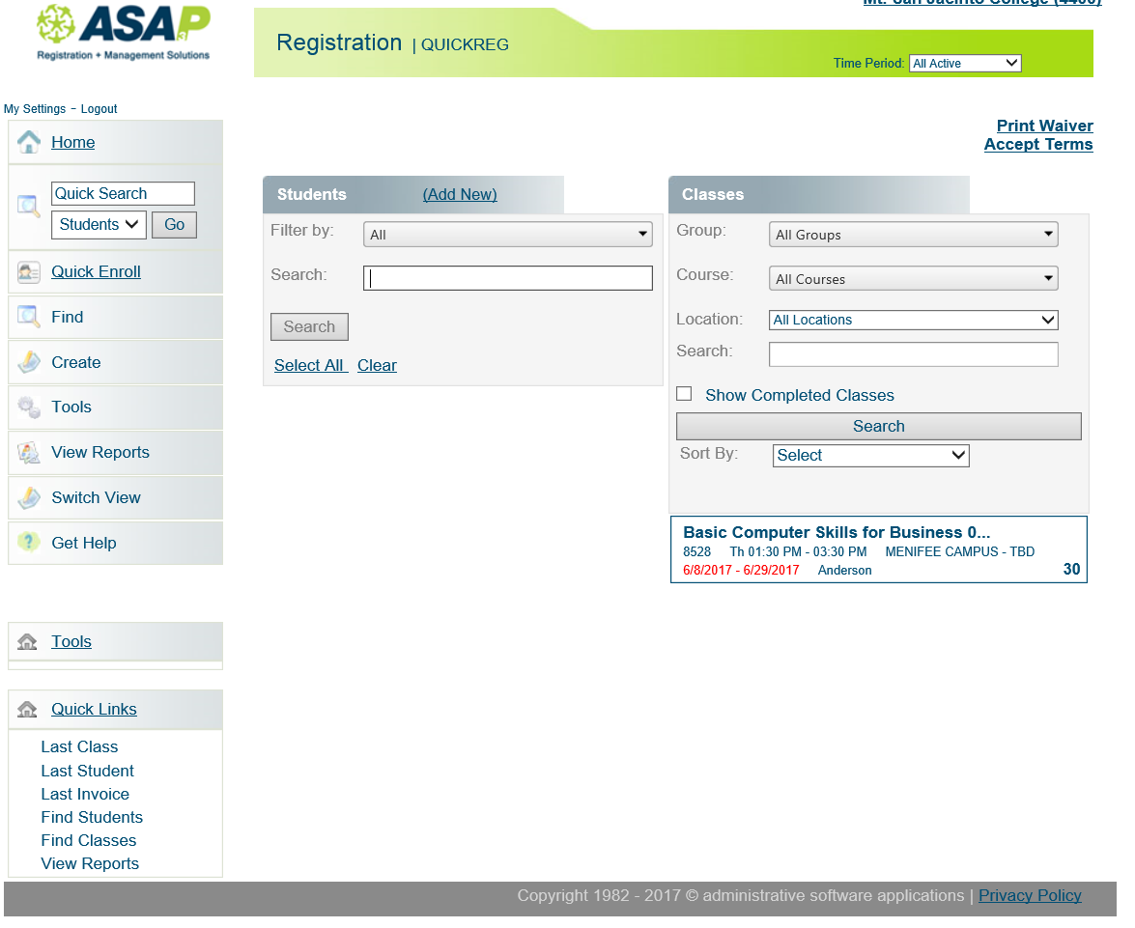
1. Type students name
2. Click “Search”
Class Information

Slide 3
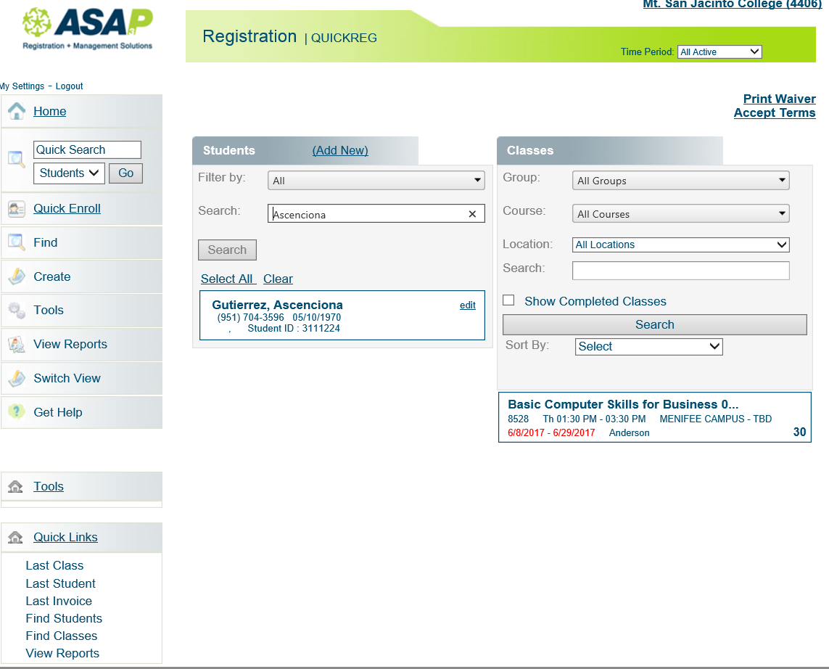
Select Student Name
Verify students D.O.B. or Phone #
Select Class

Slide 4
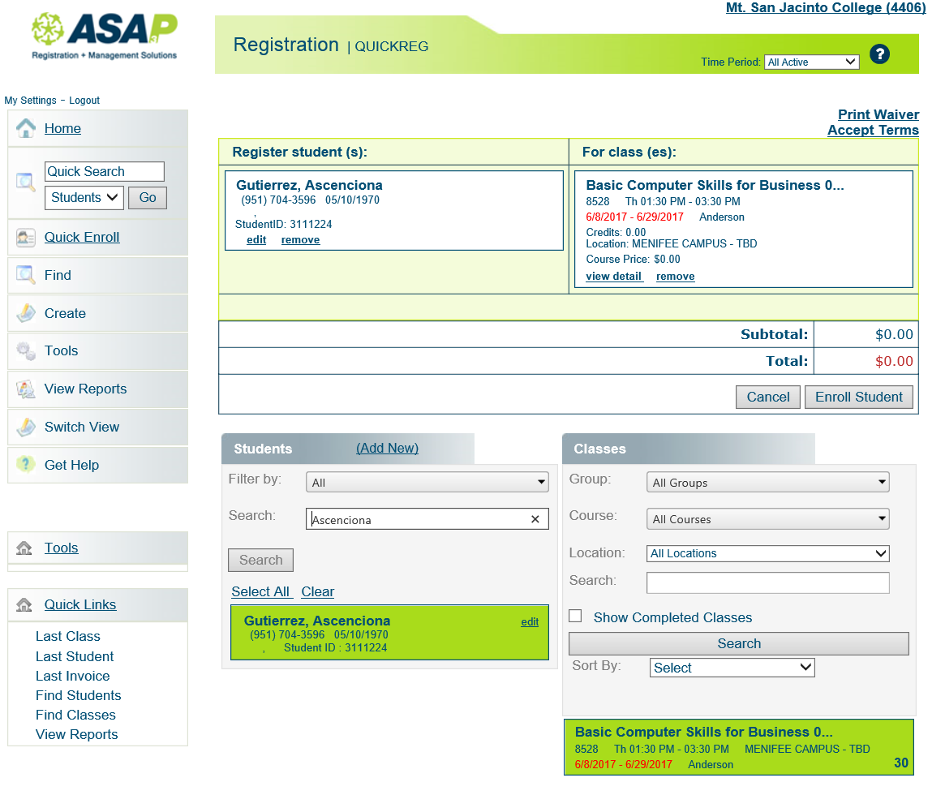
Click “Enroll Student”
**Even though you may get
A message that the action
Cannot be completed,
Student was enrolled**
Click on name of student
And class section to highlight
& To show on top page

Slide 5
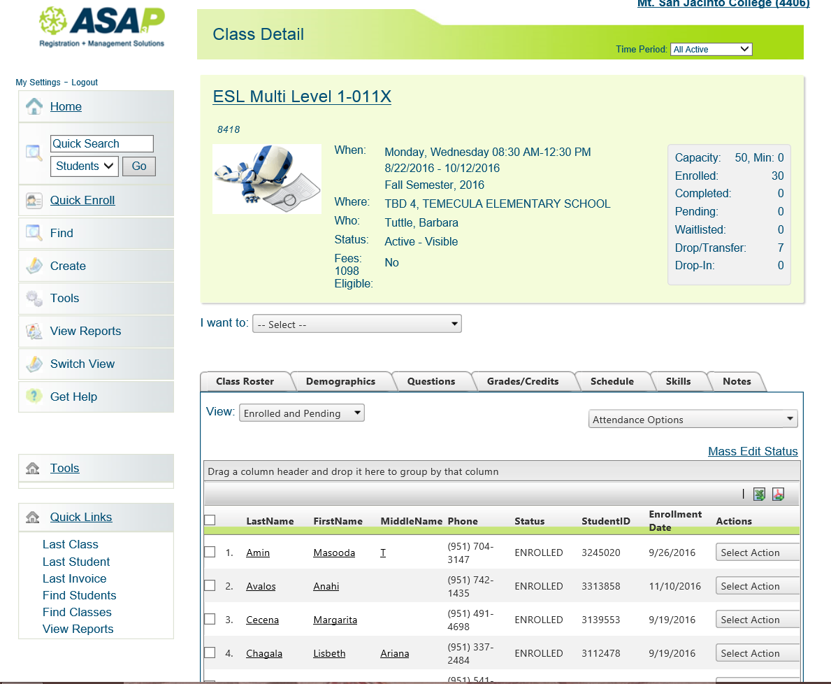
How to print Sign In Sheet
Click Drop down arrow

Slide 6
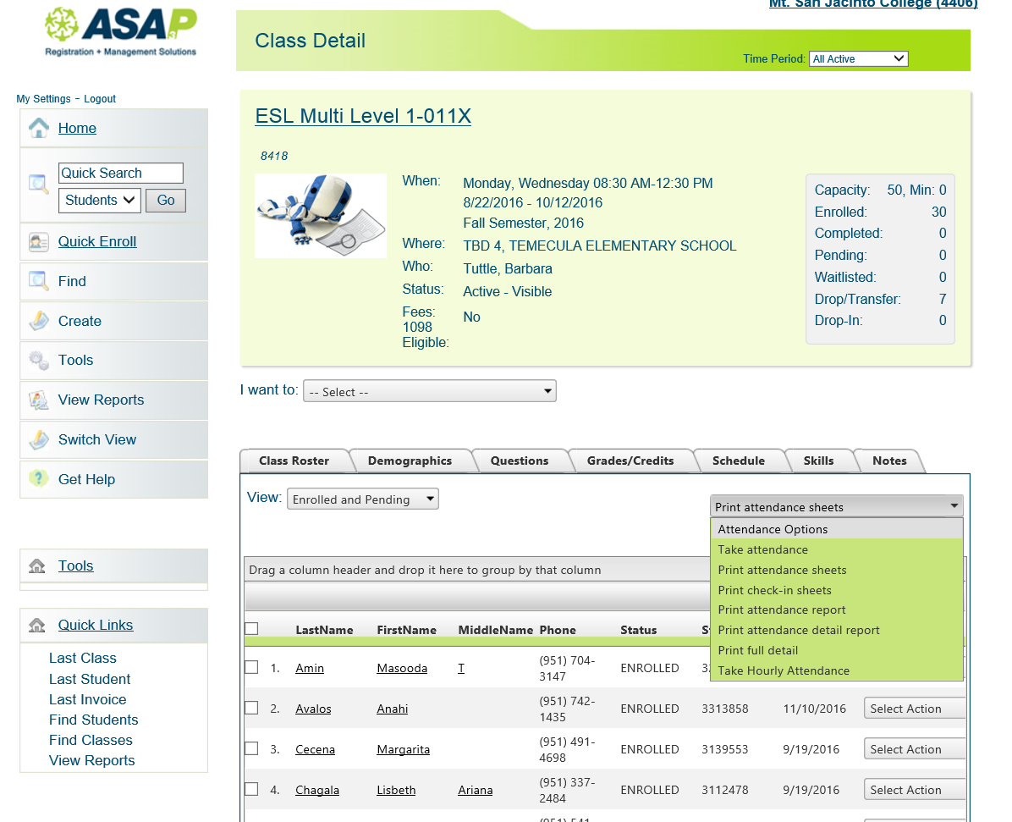
Select Print attendance Sheet

Slide 7
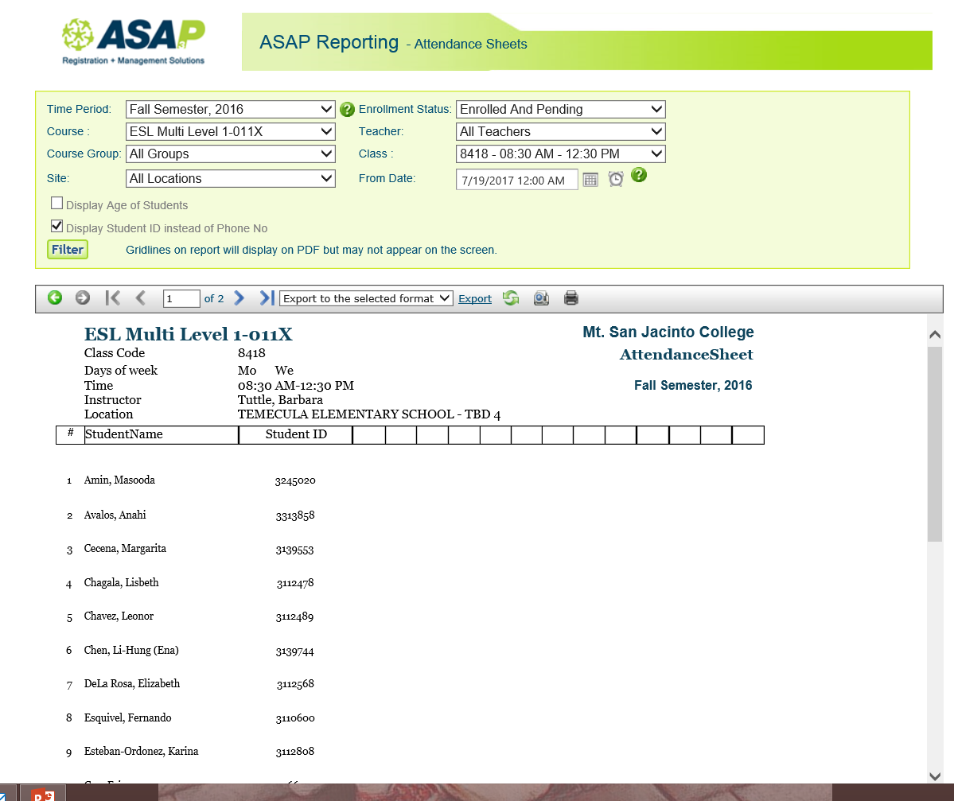
Do not Print Phone #’s
Click this box
Click “Filter”
ID #’s

Slide 8
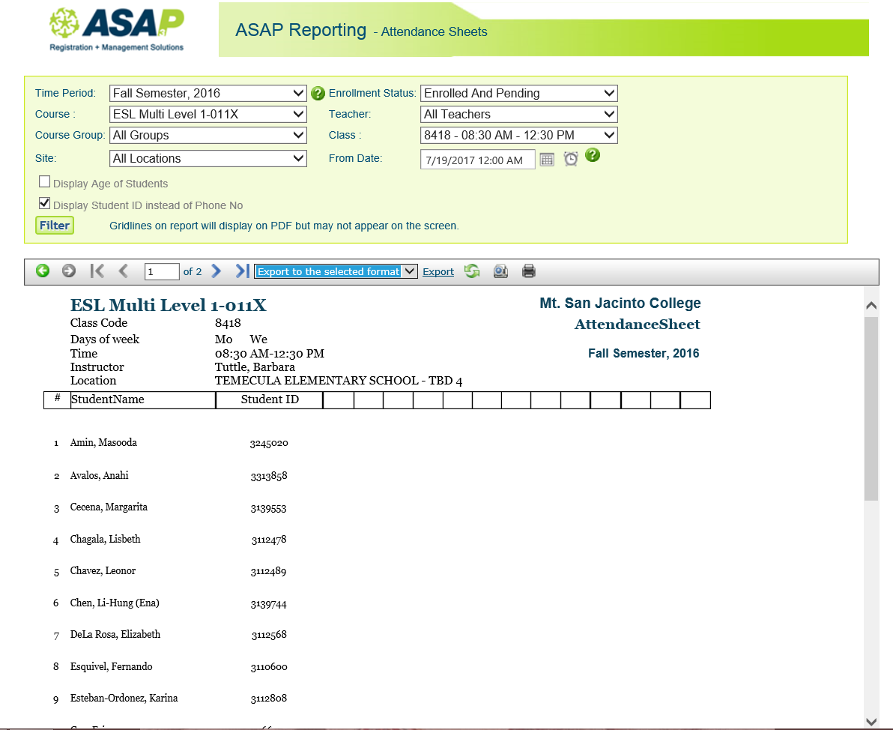
1. Click Drop down arrow Select
Acrobat PDF File
2. Click Export

Slide 9
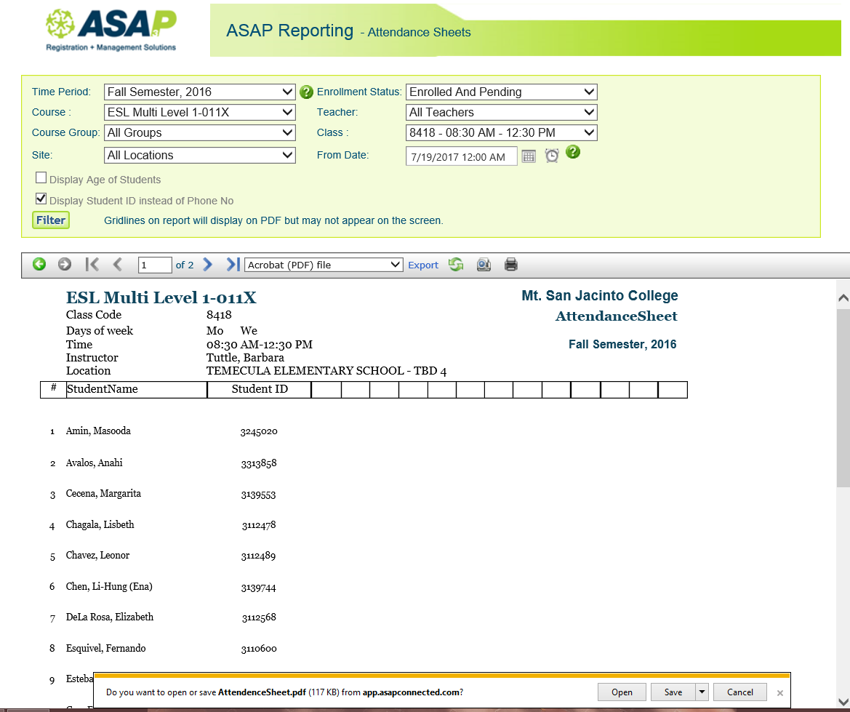
Click Open

Slide 10
Example Sign in Sheet

Slide 11
Take Attendance
Select Take Attendance

Slide 12
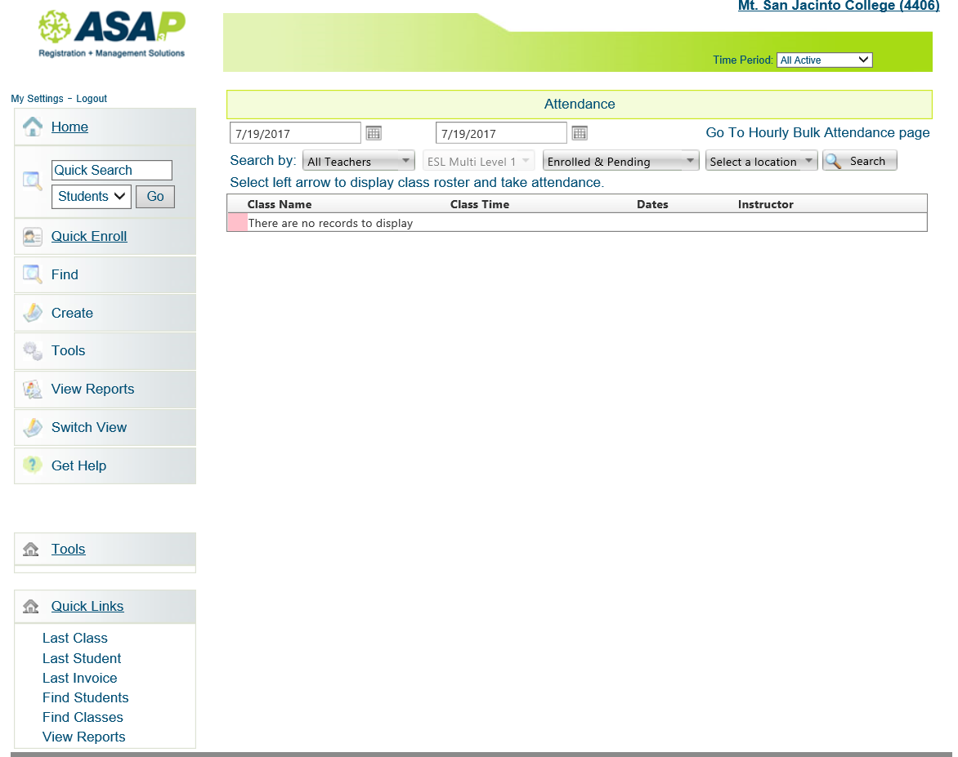
Do not Select
Bulk Attendance
1. Select the date or dates
2. Click Search
**DO NOT HIT ENTER**

Slide 13
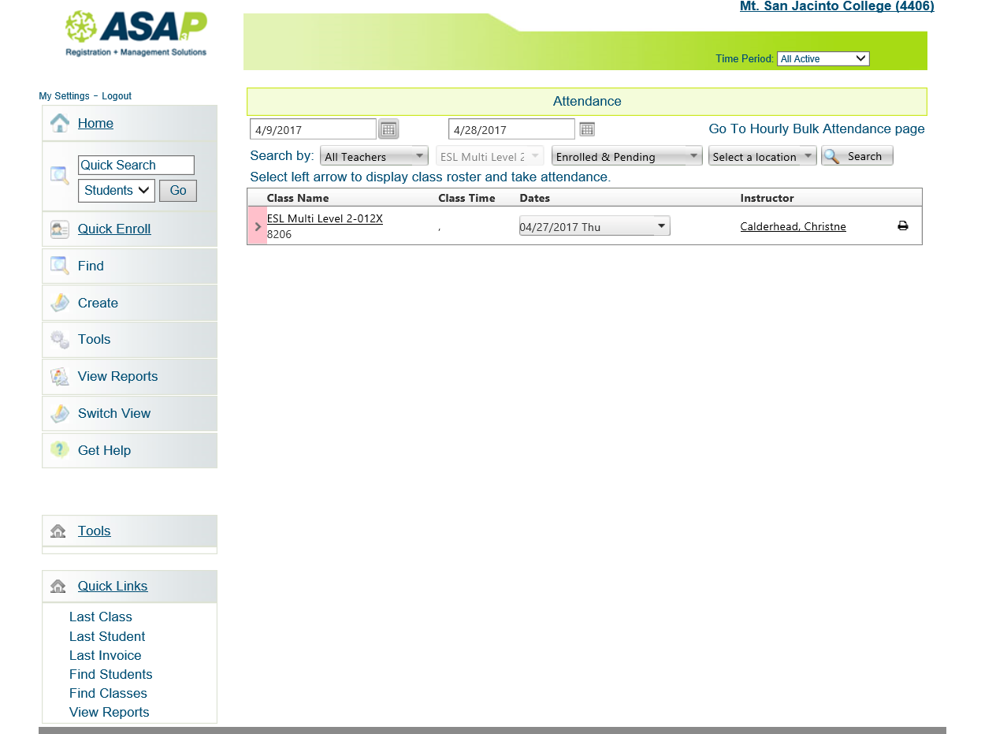
Click on class title to see class list
Drop down arrow will show you date range
Selected or if one day was selected
3. Click on arrow in pink box
To show class list & take attendance

Slide 14
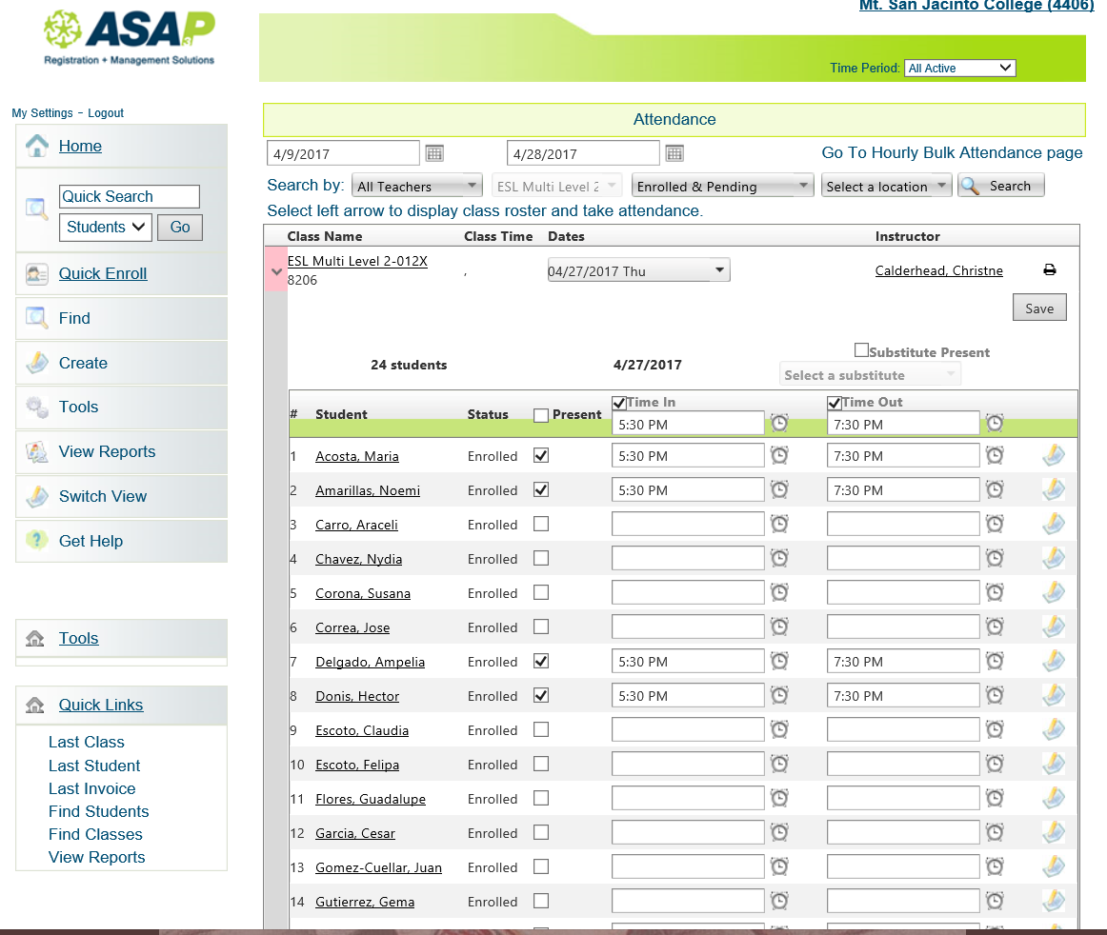
One click here will
Select ALL present
Each student can be
Selected one at a time too
By clicking on their own box
Click “save” on top
Or bottom of page

Slide 15
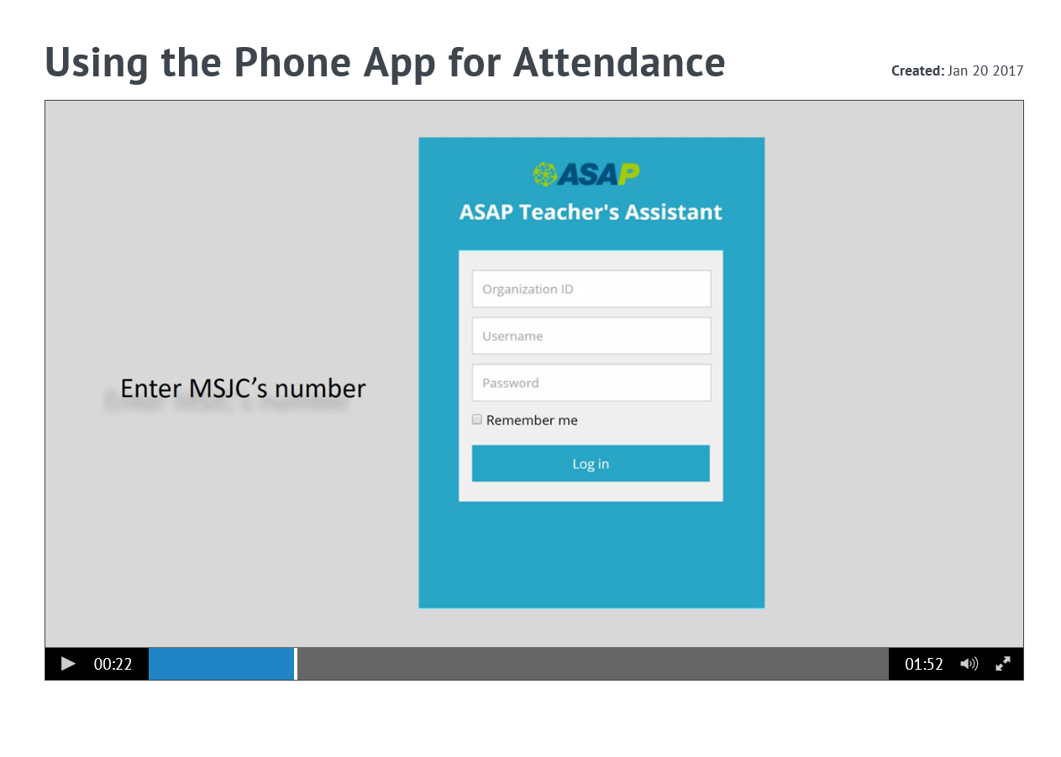
Using the Phone Application
On your phone’s Web Browser
Type
app.asapconnected.com/mobile
MSJC ID 4406
Username & Password

Slide 16
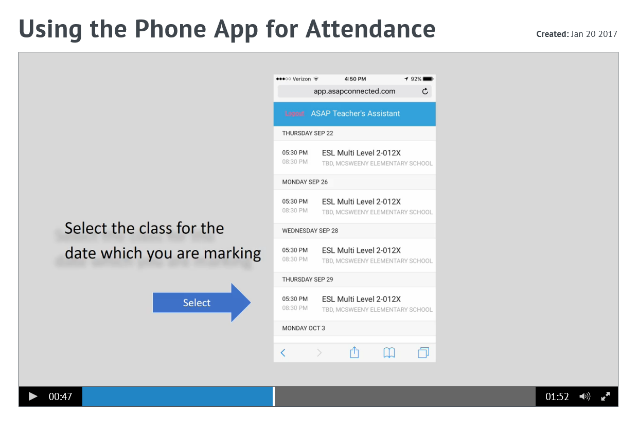

Slide 17
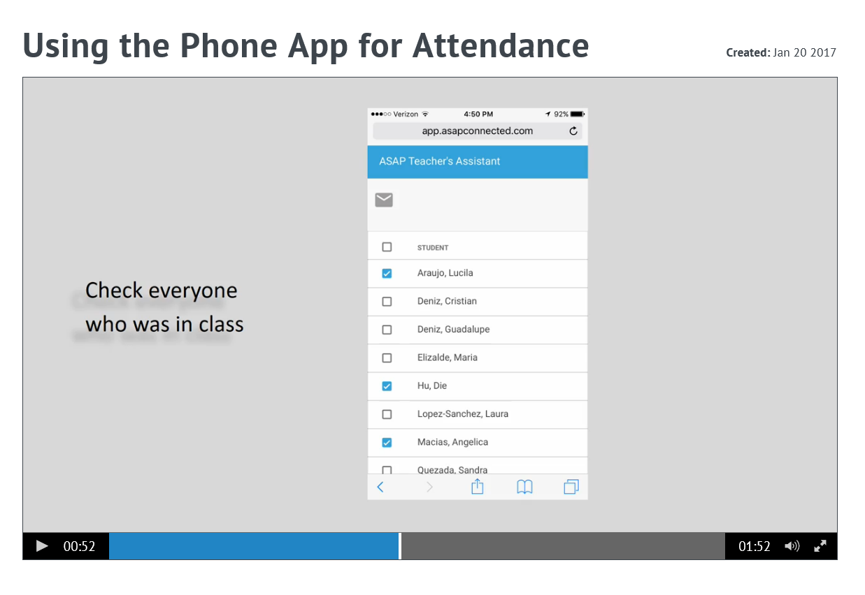

Slide 18
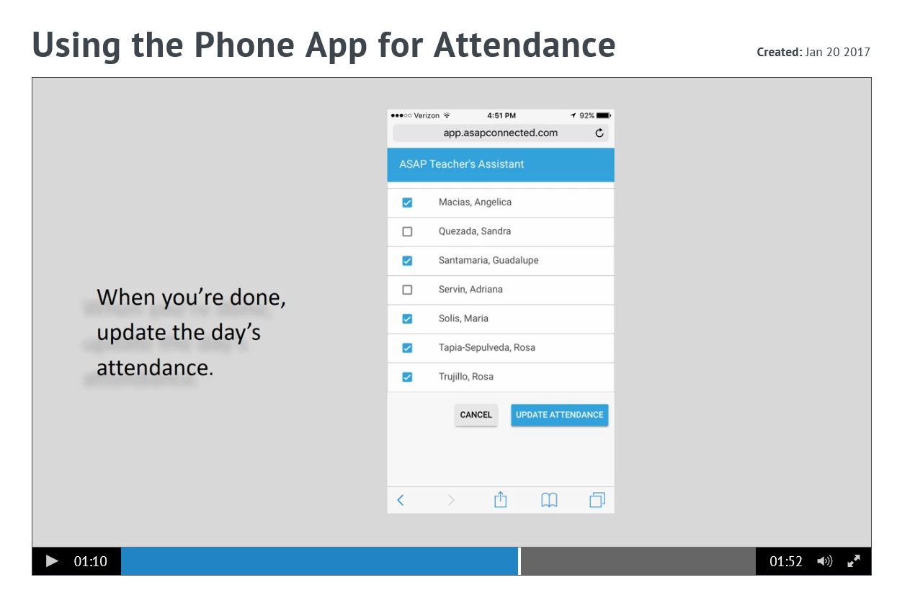
Select

Slide 19
