Slide 1
Martin Luther King Jr.
Obj. 042
Task 2 Presentation Sample

Slide 2
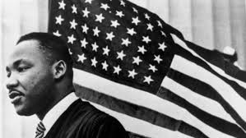
Martin luther king jr. (1929-1968)
Leader of the U.S. Civil Rights Movement
Notes:
Talking Point 1 (Good for beginning levels)

Slide 3
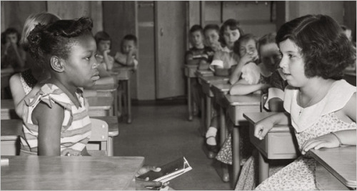
What did martin luther king jr. do?
He worked to create equal rights for African Americans.
His leadership resulted in the end of legalized segregation.
Notes:
Talking Point 2 (Good for intermediate levels)
African Americans were not treated like white Americans because of their skin color. Segregation were laws requiring separate hotels, restaurants, schools, and bathrooms.
MLK used a combination of speeches and nonviolent protests to fight segregation and achieve civil rights for African Americans.

Slide 4
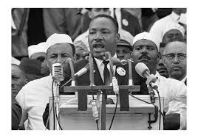
I have a dream speech 1963
Watch a clip:
https://www.youtube.com/watch?v=_IB0i6bJIjw
Notes:
(Intermediate- Advanced Levels)
This speech was important because it brought greater attention to Civil Rights Movement.
More people knew who MLK was.
Congress moved faster in passing the Civil Rights Act.

Slide 5
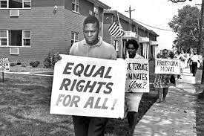
Impact on American society
Civil Rights Act (1964):
Outlaws discrimination based on race, color, religion, sex, or national origin.
Notes:
Talking Point 3 (Advanced levels)
His work helped to create the Civil Rights Act (1964) that outlaws discrimination based on race, color, religion, sex, or national origin.

Slide 6
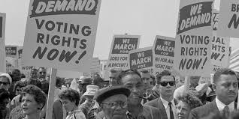
Impact on American society
Voting Rights Act (1965)
Overcame legal barriers that prevented African Americans from exercising their right to vote.
Notes:
Talking Point 3 (Advanced levels)
His work led to the Voting Rights Act (1965) which aimed to overcome legal barriers that prevented African Americans from exercising their right to vote guaranteed by the 15th Amendment of the U.S. Constitution.

Slide 7
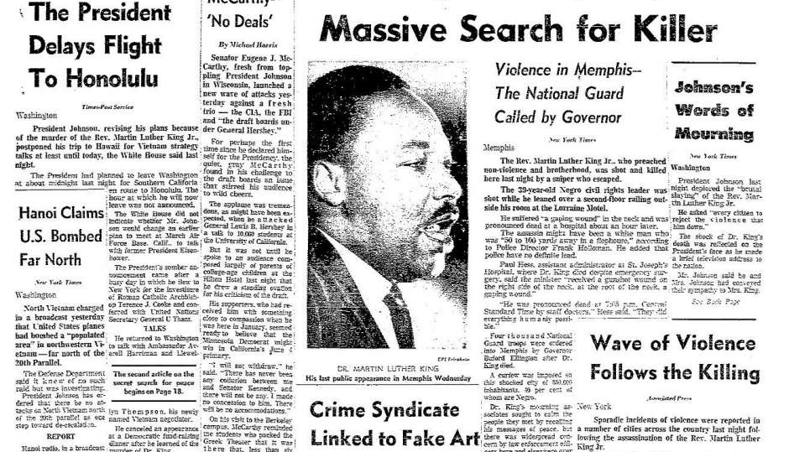
Martin Luther King Jr. Assassination 1968
Notes:
MLK had come to Tennessee to lead a march of striking sanitation workers when he was shot from the second floor balcony of his motel room. He was shot by small time criminal James Earl Ray. People were shocked and devastated. Rioting exploded in over 100 American cities at the news.
Image from: SF Chronicle

Slide 8
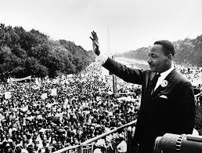
What MLK Means to me
Notes:
Talking Point 4 (All students must respond)
Possible answers:
MLK is inspiring to me because his work helped guarantee the freedoms and rights I have as a future American citizen.
MLK is important to me because he fought for the equality of all people.

