Slide 1
Handwashing and
Food Choices
Obj. 046: Practice for Task 1, Part 1

Slide 2
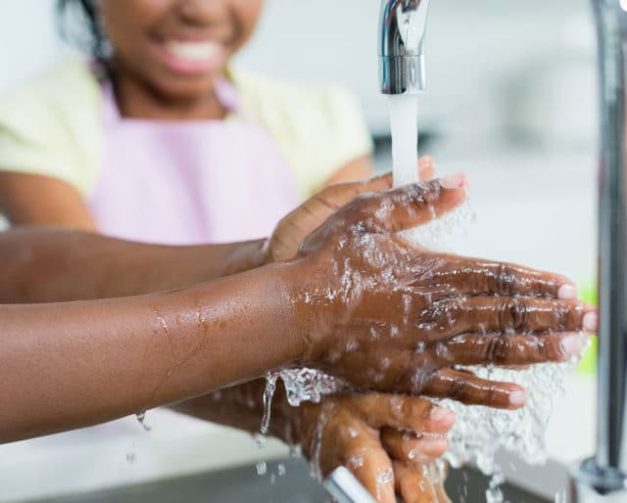
Task 1 Part 1: Handwashing

Slide 3
Task 1, Part 1 Key Words
Hands
Garbage
Bathroom
Raw Meat
Coughing
Eating
Cooking
In order (chronological)
Before/After
To Wash
To Wet
To apply / to soap
To Scrub / Rub
To Rinse
To Dry

Slide 4
When should you wash your hands?
Situations Before: Situations After:
1. 1.
2. 2.
3. 3.
4. 4.

Slide 5
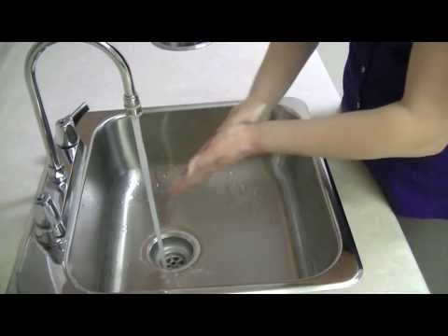
Handwashing Video

Slide 6
5 Main Handwashing Steps
1.
2.
3.
4.
5.

Slide 7
Handwashing and
Food Choices
Obj. 046: Practice for Task 1, Part 2

Slide 8
Cross-Contamination

Slide 9
Task 1, Part 2 Key Words
To Prevent
Cleanliness
Cross-Contamination
To Contaminate
Hygiene
Rotten
Bacteria
To Spoil (spoiled)
To Separate
Food poisoning

Slide 10
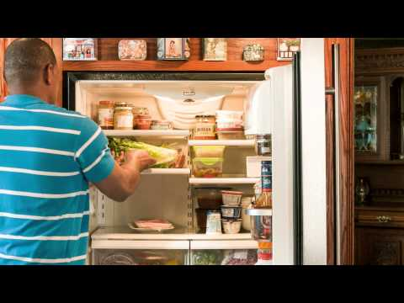
Cross-Contamination Video

Slide 11
What does Terrance do right? What does Terrance do wrong?
When shopping
In his refrigerator
With a cutting board
With washing his hands
Using the food thermometer

Slide 12
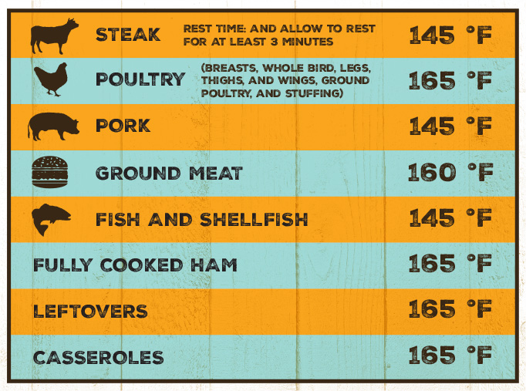
Correct Temperatures

Slide 13
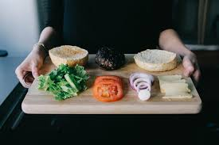
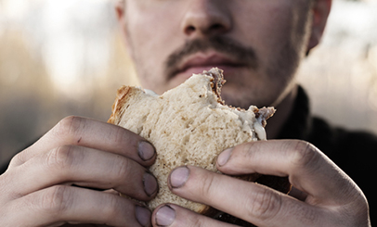
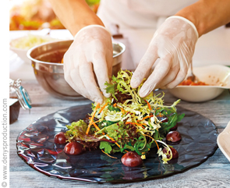
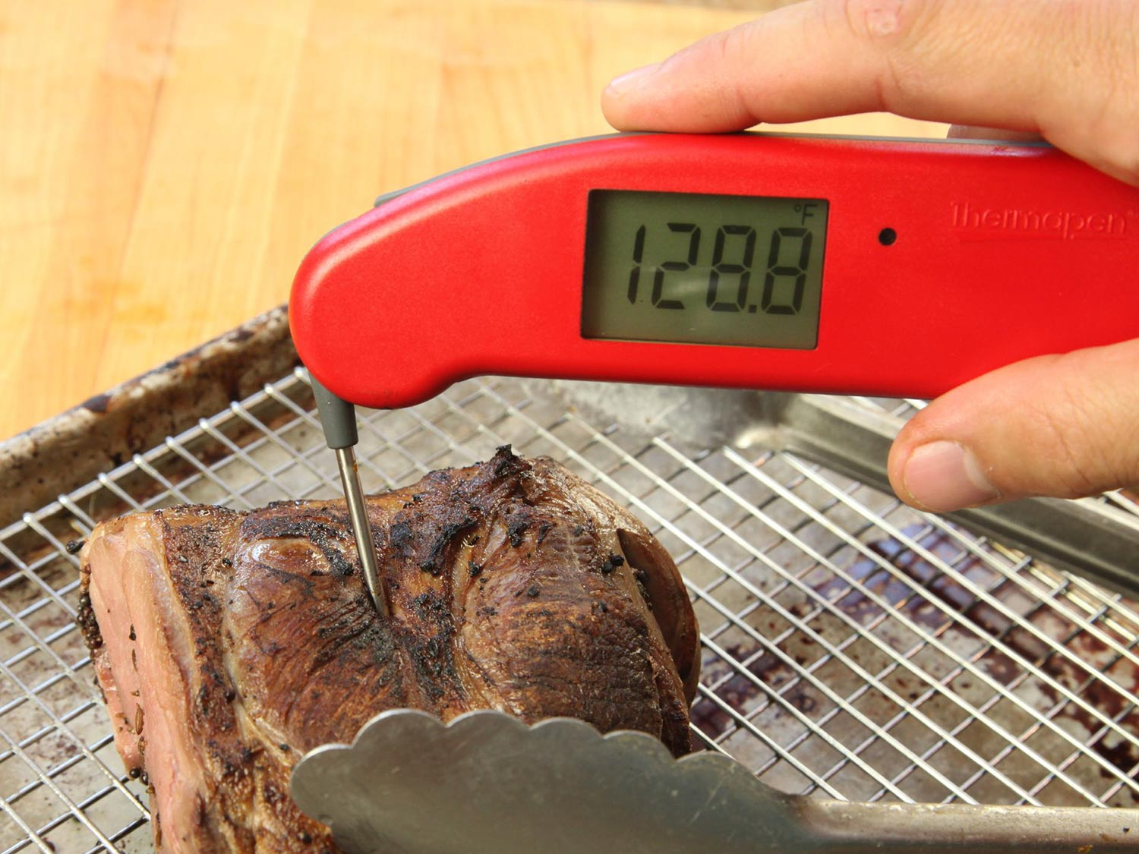
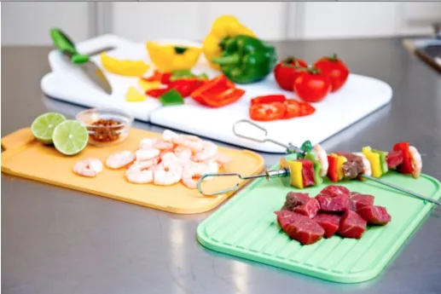
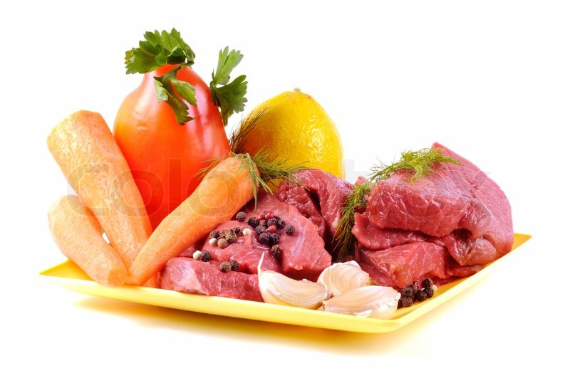
Which are wrong??

Slide 14
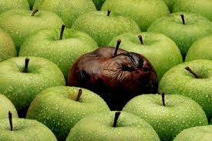
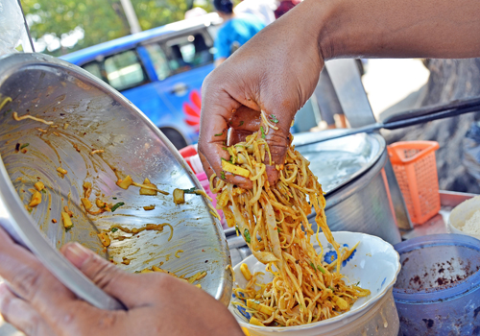
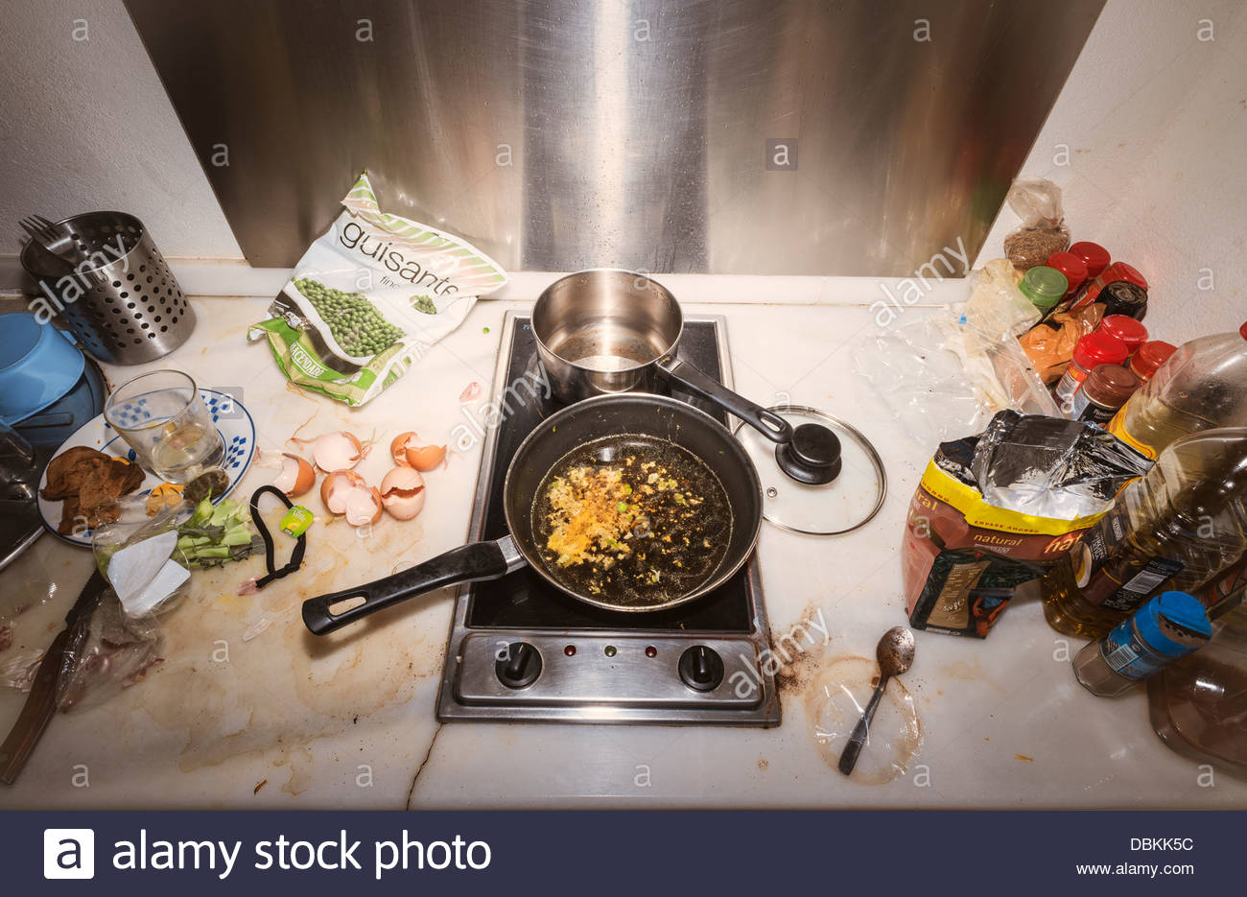
What is wrong? How could Cross-Contamination be prevented?

Slide 15
Analyzing Eating Habits
Obj. 046: Practice for Task 2

Slide 16
Task 2
What is difficult about eating in a healthy way?
How does your diet in the U.S. compare to your diet in another country?
Whose advice do you follow about your eating habits?

Slide 17
Task 2 Key Words
Healthy/Unhealthy
Replacement
Diet
Eating Habits
To Recommend
Portion Control
Balance
Whole grain foods
Fried Foods
Breakfast, Lunch, Dinner
Carbohydrates / carbs
Sugar
Calories
Sodium
Fiber
Protein

Slide 18
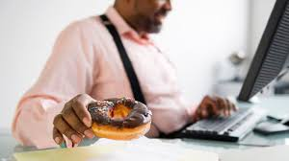
Picture 1 What’s Unhealthy? What should someone eat instead?

Slide 19
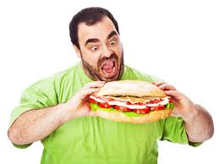
Picture 2 What’s Unhealthy? What should someone eat instead?

Slide 20
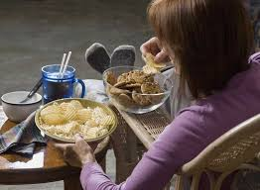
Picture 3 What’s Unhealthy? What should someone eat instead?

Slide 21
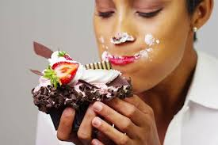
Picture 4 What’s Unhealthy? What should someone eat instead?

Slide 22
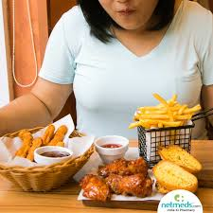
Picture 5 What’s Unhealthy? What should someone eat instead?

Slide 23
Comparing Shopping List
Obj 046: Practice for Task 3

Slide 24
Task 3 Key Words
Price
Cheapest / Most Economical
Location
Buy
Produce

Slide 25
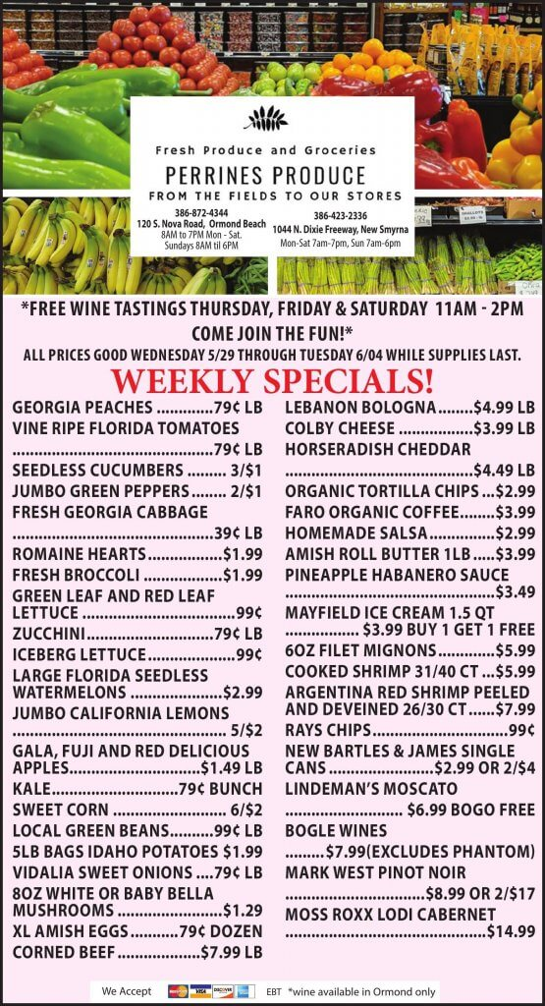
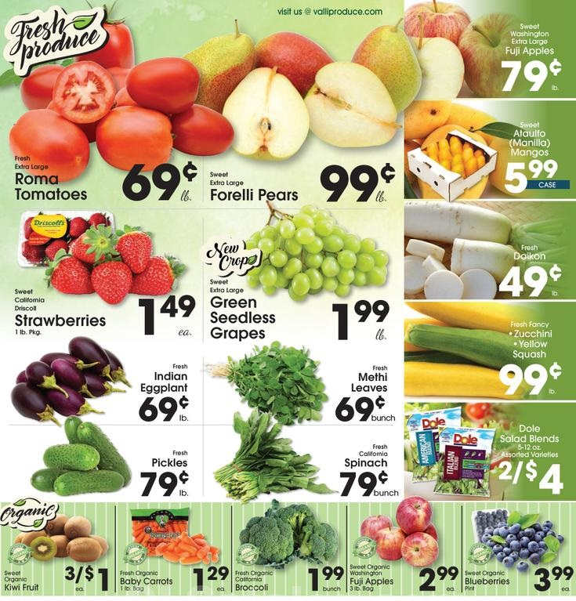
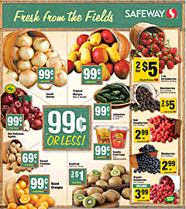
Task 3 Store Ads

Slide 26
Comparison Chart
Vegetable/Fruit | Price at _________ | Price at _________
1
2
3
4
5

Slide 27
Write about Food Product Choices & Dietary Needs
Obj 046: Practice for Task 4

Slide 28
Task 4 Key Words
Dietary Needs
Health issues
Disease
Reasoning
Restricted
Resources

Slide 29
Task 4
Read the article.
What is the dietary need?
What is healthy for people in this situation?
Why is it good?
What is unhealthy/bad for them?
Why is it bad?
How does the author persuade or convince the reader of their reasoning?

Slide 30
Original Article
“Maintaining A Healthy Diet Can Help Protect Vision from Age-related Macular Degeneration”
CHICAGO(Jan. 24, 2012)–We’ve all heard the expression “eating with your eyes,” but many people may not be aware of the benefits of eating for your eyes. In addition to promoting overall health, a diet rich with sight-saving beta carotene, lutein, zeaxanthin, zinc, omega-3 fatty acids and certain vitamins can also help guard against vision loss from eye disease, such as age-related macular degeneration (AMD).
AMD diminishes central vision and currently affects the vision of more than 2 million Americans, ages 50 and older and is a leading cause of blindness. AMD is a progressive disease that if left untreated, can result in severe vision loss and even blindness. The exact cause of AMD is unknown, but risk factors for the disease include age, race, smoking, family history as well as those with cardiovascular disease and hypertension.

Slide 31
“Maintaining A Healthy Diet Can Help Protect Vision from Age-related Macular Degeneration” page 2
A wide variety of foods including lentils, grapes, carrots, bell peppers, broccoli, spinach, sweet potatoes, kale, certain kinds of fish, turkey and some kinds of nuts, have been shown to aid eye health. Although there are a variety of available over-the-counter supplements designed for vision and eye health, a doctor should always be consulted before use.
Foods that contain refined starches and are high in sugar can be damaging to vision. A study by Tufts University showed that high-glycemic foods cause a dramatic rise in blood sugar, which over time, may damage the retina and capillaries in the eye by promoting oxidative stress and inflammation. Soda and sugary drinks, candy, baked goods, some cereals, white rice, foods made with white flour, such as white bread and pasta, should be avoided.

Slide 32
“Maintaining A Healthy Diet Can Help Protect Vision from Age-related Macular Degeneration” page 3
According to the University of Illinois Eye and Ear Infirmary, more than one serving per week of beef, pork, or lamb as a main dish is associated with a 35 percent increased risk of macular degeneration as compared with less than three servings per month. Additionally, one serving per day of high-fat dairy food, such as whole milk, ice cream, hard cheese, or butter, also increases the risk of macular degeneration progression.
“We all know that watching what we eat can lead to overall health benefits such as lower cholesterol and a reduction of calories, but maintaining a healthy diet, day after day, can be very challenging,” said Hugh R. Parry, president and CEO of Prevent Blindness America. “Prevent Blindness America hopes to encourage the public to remember that everything we put in our mouths can affect our eyes!”

Slide 33
“Maintaining A Healthy Diet Can Help Protect Vision from Age-related Macular Degeneration” page 4
Other healthy habits can lead to healthy vision. The risk of eye disease and vision loss can be lowered by:
Avoiding trans fats
Quitting smoking
Controlling blood pressure and cholesterol
Exercising regularly
Visiting an eye care professional on a regular basis
Resource: Prevent Blindness America https://www.preventblindness.org/healthy-diet-can-help-protect-vision

Slide 34
Example Article for Task 4
Dietary Needs for Healthy Eyes
In order to have healthy eyesight, people need to have a diet that helps protect their vision. Foods like carrots, bell peppers and sweet potatoes have been proven to support healthy vision. These foods are rich in fiber and vitamins that are good for your eyes. Drinking lots of sugary drinks or eating too much meat is known to put people at risk of Macular Degeneration. It would be better to eat three servings of meat a month instead of eating meats on a weekly basis. It is important to eat healthfully for our eyes now so that our vision is protected in old age.
Resource: Prevent Blindness America https://www.preventblindness.org/healthy-diet-can-help-protect-vision

Slide 35
Write About It
In pairs or groups, choose a dietary need and research it online.
Answer all of the above questions AND
Write a cohesive paragraph (8-10 sentences) that includes a
Title
Direct statement about the dietary need they have chosen
What they have found to be healthy and unhealthy for these people
A persuasive argument for a healthy diet
Resource information (website, author, date, etc.)

