Slide 1
Objective 033
Task 1 Practice:
Employment and Training Resources

Slide 2
Task 1: Idenitfy Jobs and Job Duties

Slide 3
Occupation = job

Slide 4

What is the Occupation (job)?
What does this person do?

Slide 5

Occupation:
Doctor
What Does this Person Do?
Treats patients

Slide 6

Occupation:
Cook
What Does this Person Do?
Cooks food

Slide 7
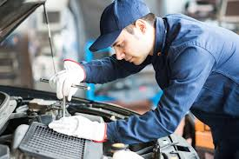
Occupation:
Mechanic
What Does this Person Do?
Fixes cars and trucks

Slide 8

Occupation:
Welder
What Does this Person Do?
Welds metals

Slide 9

Occupation:
Teacher
What Does this Person Do?
Teaches students

Slide 10

Occupation:
Manager
What Does this Person Do?
Manages employees

Slide 11
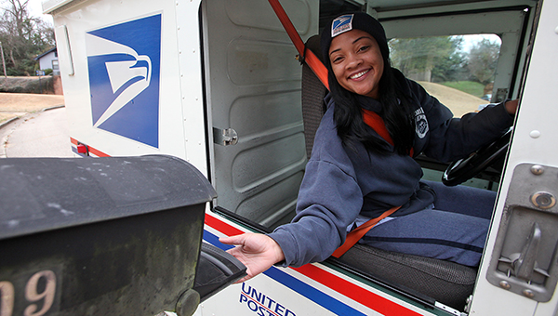
Occupation:
Mail Carrier
What Does this Person Do?
Delivers mail

Slide 12
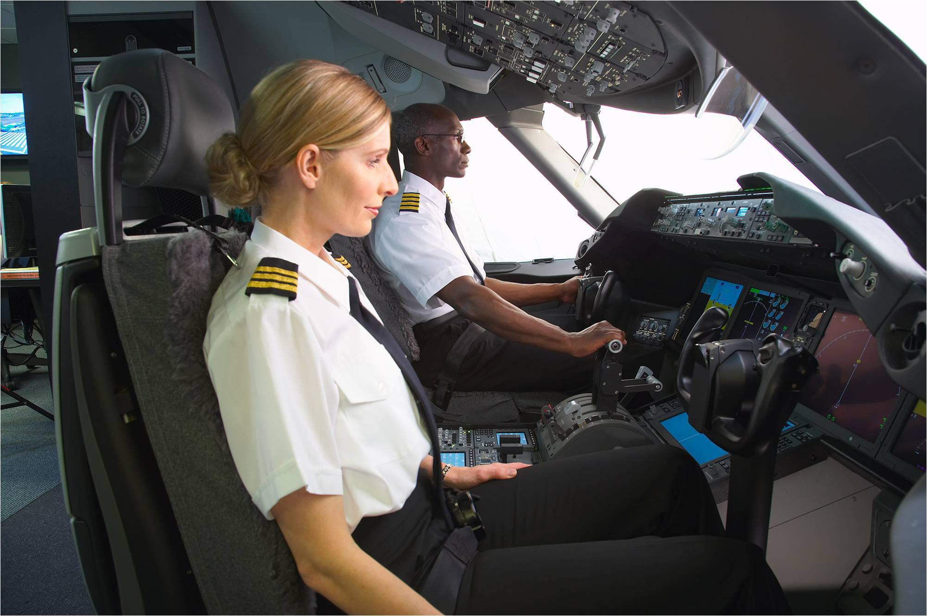
Occupation:
Pilot
What Does this Person Do?
Flies airplanes

Slide 13
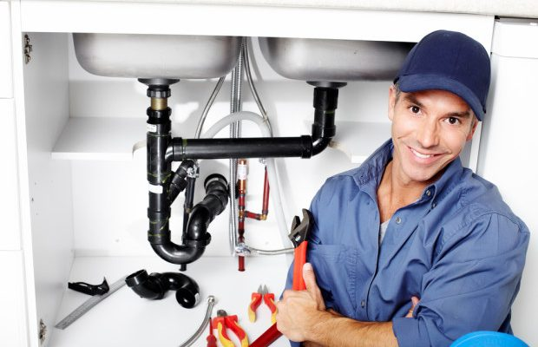
Occupation:
Plumber
What Does this Person Do?
Repairs sinks, pipes

Slide 14

Occupation:
Carpenter
What Does this Person Do?
Builds things with
wood

