Slide 1
Objective 033
Presentation Tips:
Employment and Training Resources

Slide 2
Before your presentation:
Decide team roles.
Plan presentation.
Make visual aid.
Make note cards.

Slide 3
Team Member Roles:
What is the job name/description?
Are local jobs available? What is the wage or salary?
Student 1
Beg. 3 / Int. 1

Slide 4
Team Member Roles:
What education, training, credentials or certificates are required?
What experience is required?
Student 2
Int. 2 / Adv.

Slide 5
Team Member Roles:
What are the working conditions/job duties?
5 reasons why do you want this job?
Student 3
Int. 2 / Adv.

Slide 6
Introductions:
“Hi, my name is ________.
My teammates are_______ and _______.
Today we will talk about _________.
First, _______ will talk about _________.”
Practice

Slide 7
Transitions:
“And now ____will talk about _________.”
“Next, ______will discuss __________.”
How to move from one speaker to the next

Slide 8
Day of the Presentation:
All presenters will stand up front.
Decide who will hold the visual aid/remote for the PPT!
You can use your note cards BUT don’t read the entire time!
General Rules

Slide 9
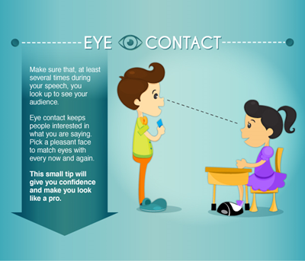
Remember:
Confident posture.
Do not chew gum :)
Accurate content (ask your teacher to check your grammar).
Pleasant face.
Good eye contact.
Gestures where appropriate.

Slide 10
Good Luck!

