Slide 1
Research & Reflect on Work/Secondary Education Opportunities
EL Civics Objective 051

Slide 2
Discussion Questions
What is your dream job?
How would you look for that job?
How do you know if you are qualified for that job?
Where do you look for information on job training/education?

Slide 3
The Task
In order to find your dream job, O*NET Online has provided an interest profiler. The online quiz compares your interests with possible jobs and offers information about those jobs and the necessary education for them.
This task will help you navigate the website and online profiler.
O*NET Online: https://www.onetonline.org/
O*NET Interest Profiler: https://www.mynextmove.org/explore/ip

Slide 4
Step 2: Choose a “Job Zone” and Pick a job that fits your interests.
Fill out your Notes Sheet!
Step 1: Take the Interest Profiler Quiz and find your personality types.
Step 4: Use your notes to write a reflection, complete a comparison chart and supply a sample of your work.
1 hour
2 hours
30 mins
1 hour
15 mins
Step 3: Research schools that are best for your “dream job.”
Fill out your Notes Sheet!
Write down your results and write a Reflection.

Slide 5
Step 1: Interest Profiler
Key Words
Personal Interests
Skills
Strongest
Weakest
Career
Asses/Assessment

Slide 6
Take the Quiz
If you can, move through the quiz with your instructor.

Slide 7
How to Answer

Slide 8
Don’t Worry About It!

Slide 9
NOT A TEST

Slide 10
Page 1

Slide 11
Page 2

Slide 12
Page 3

Slide 13
Page 4

Slide 14
Page 5

Slide 15
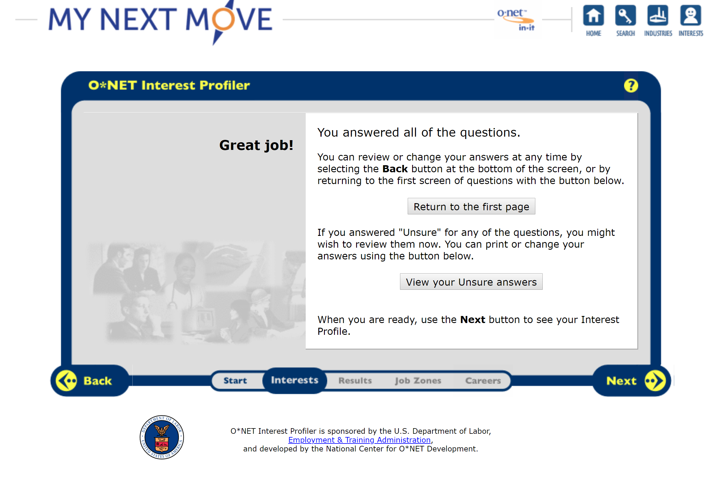
Double Check Your Answers

Slide 16
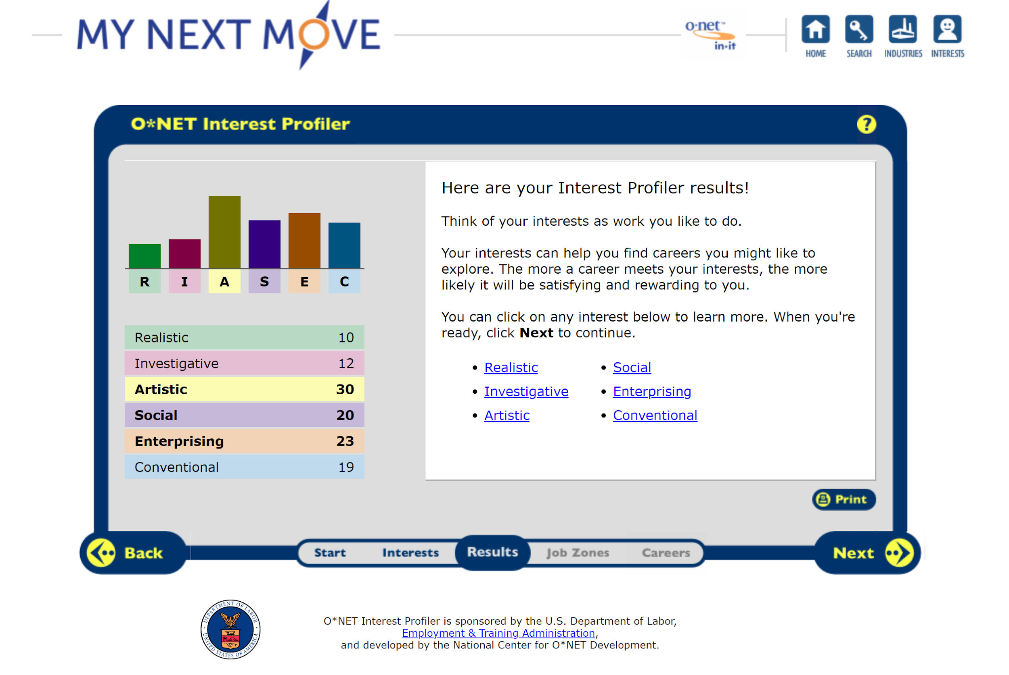
Understanding Your Results
Make sure you take notes and look through the different meanings of personality types.

Slide 17
For Example

Slide 18
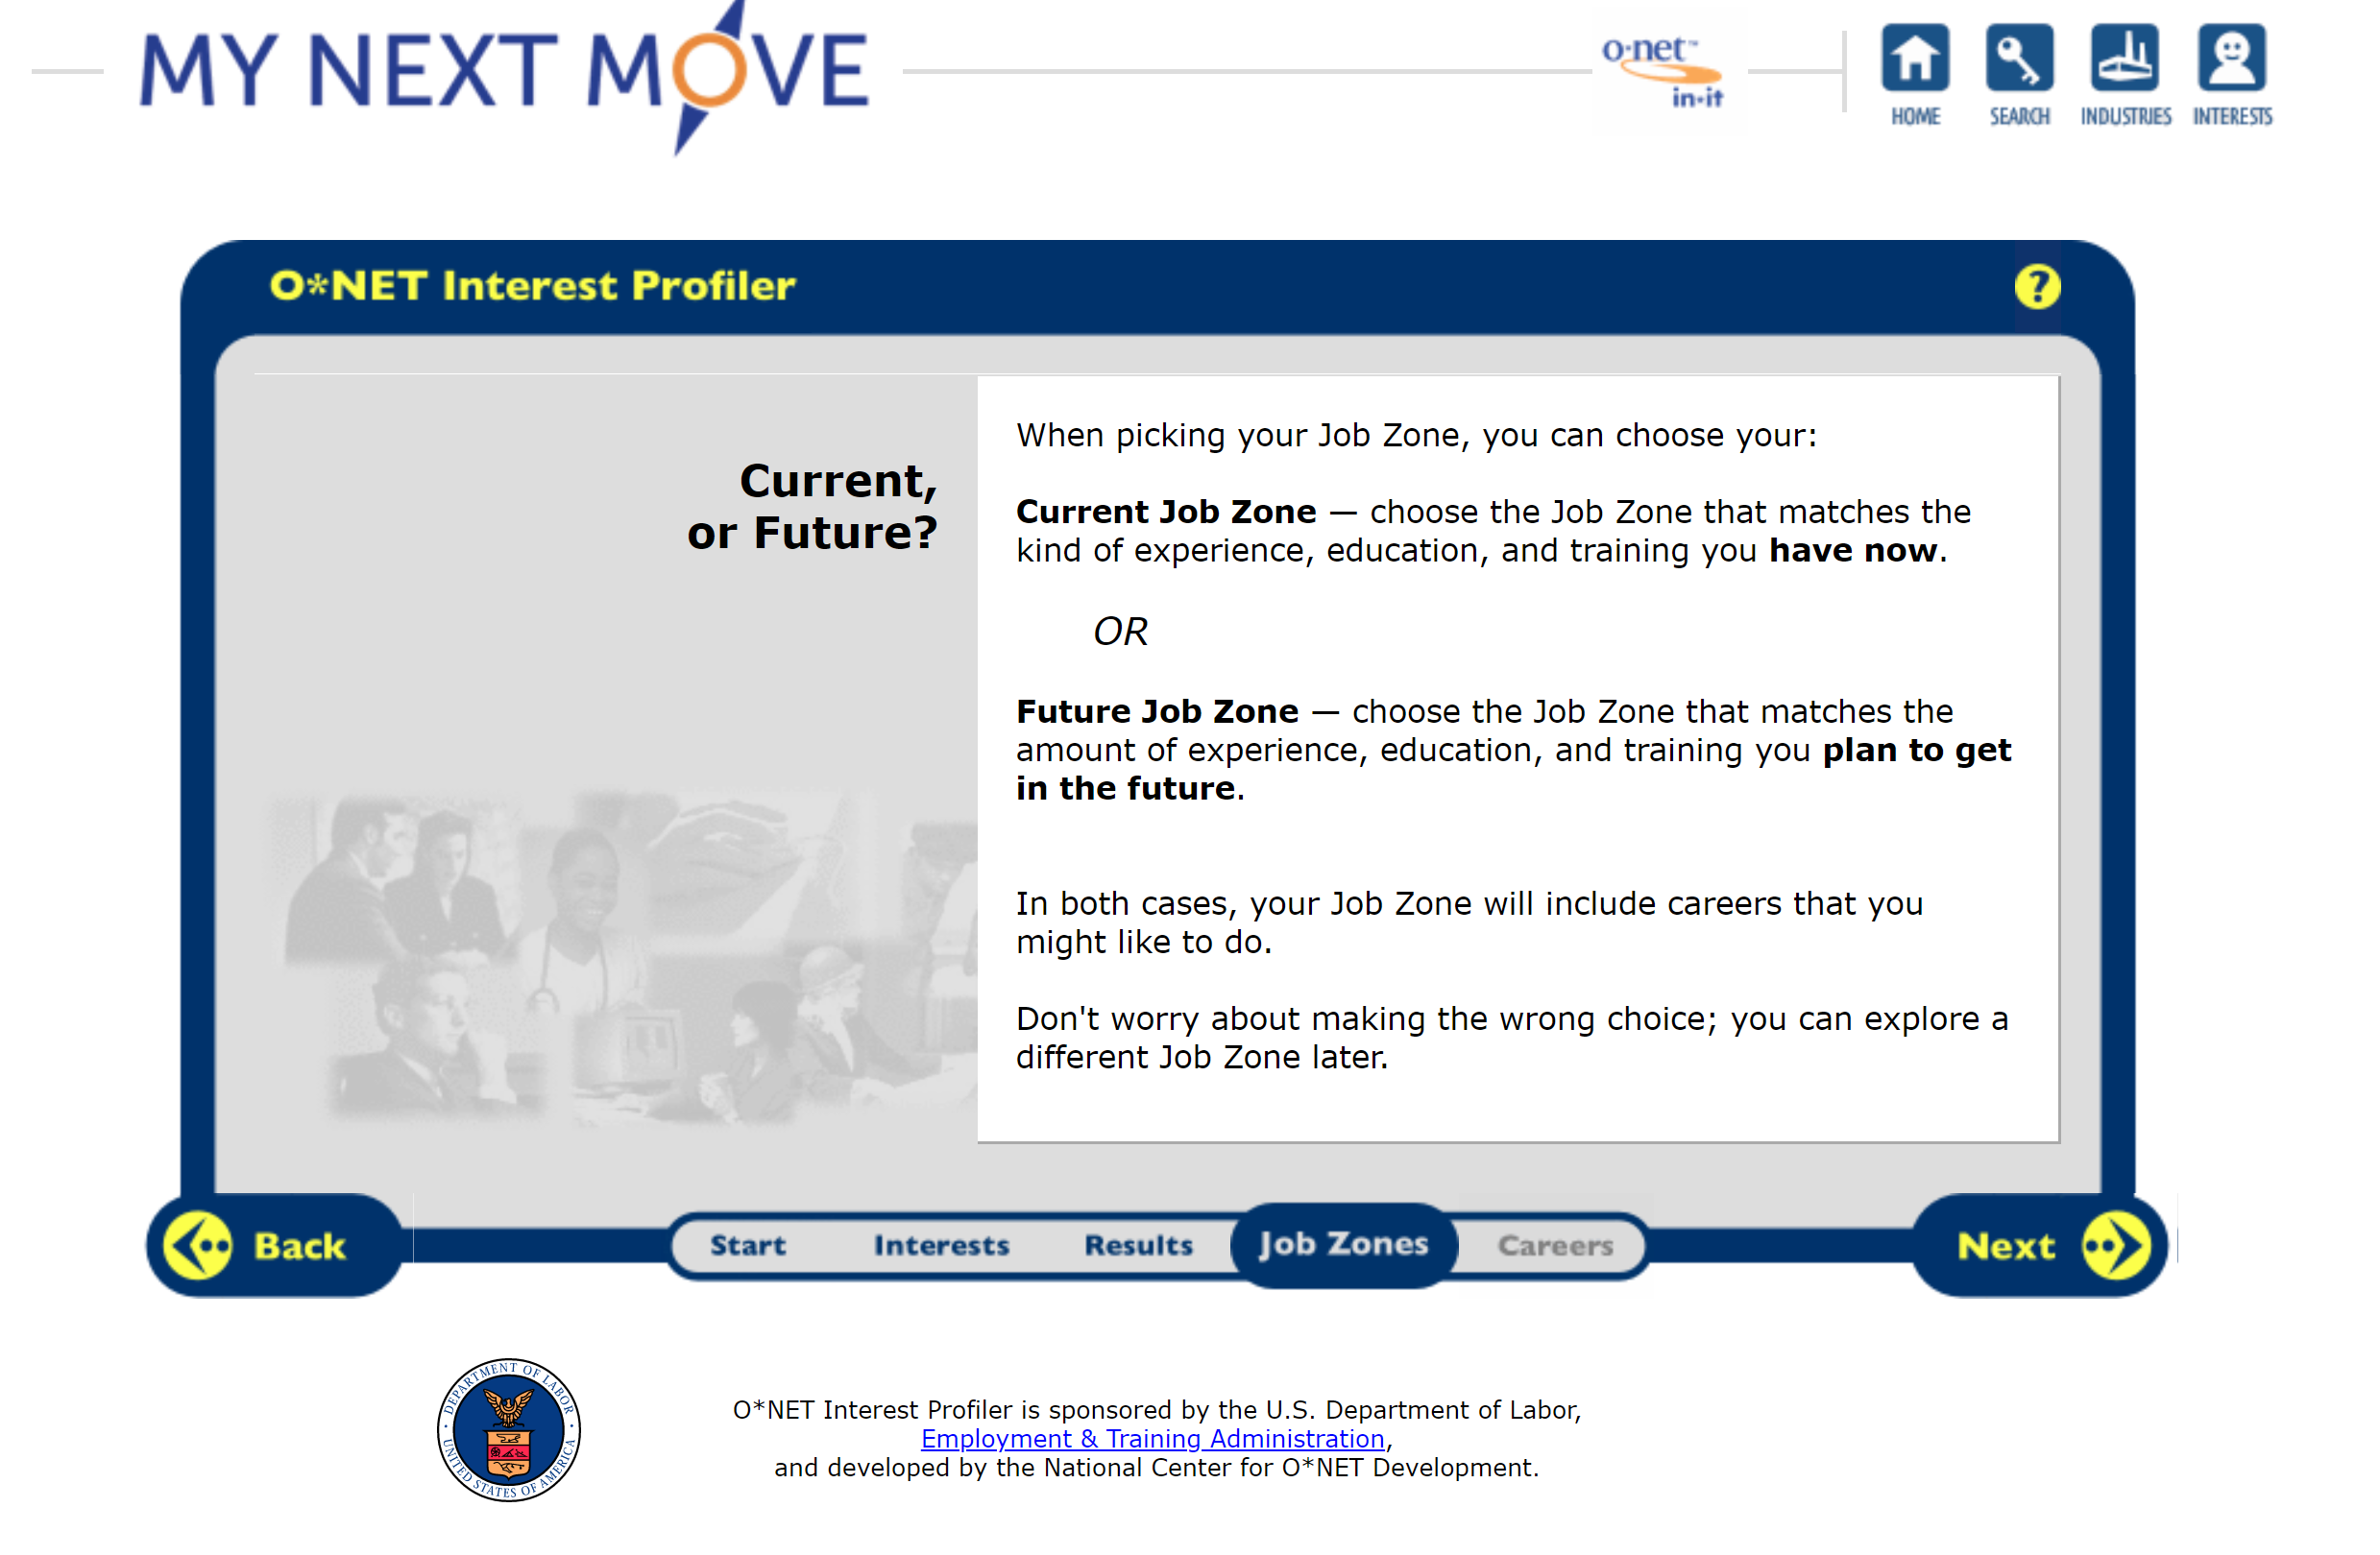
Job Zones

Slide 19
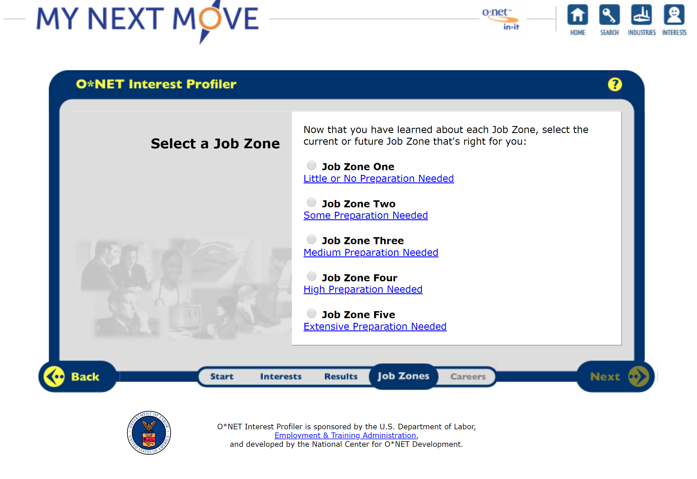
Understanding Job Zones
Click the link for each Job Zone and see which one fits you best!

Slide 20
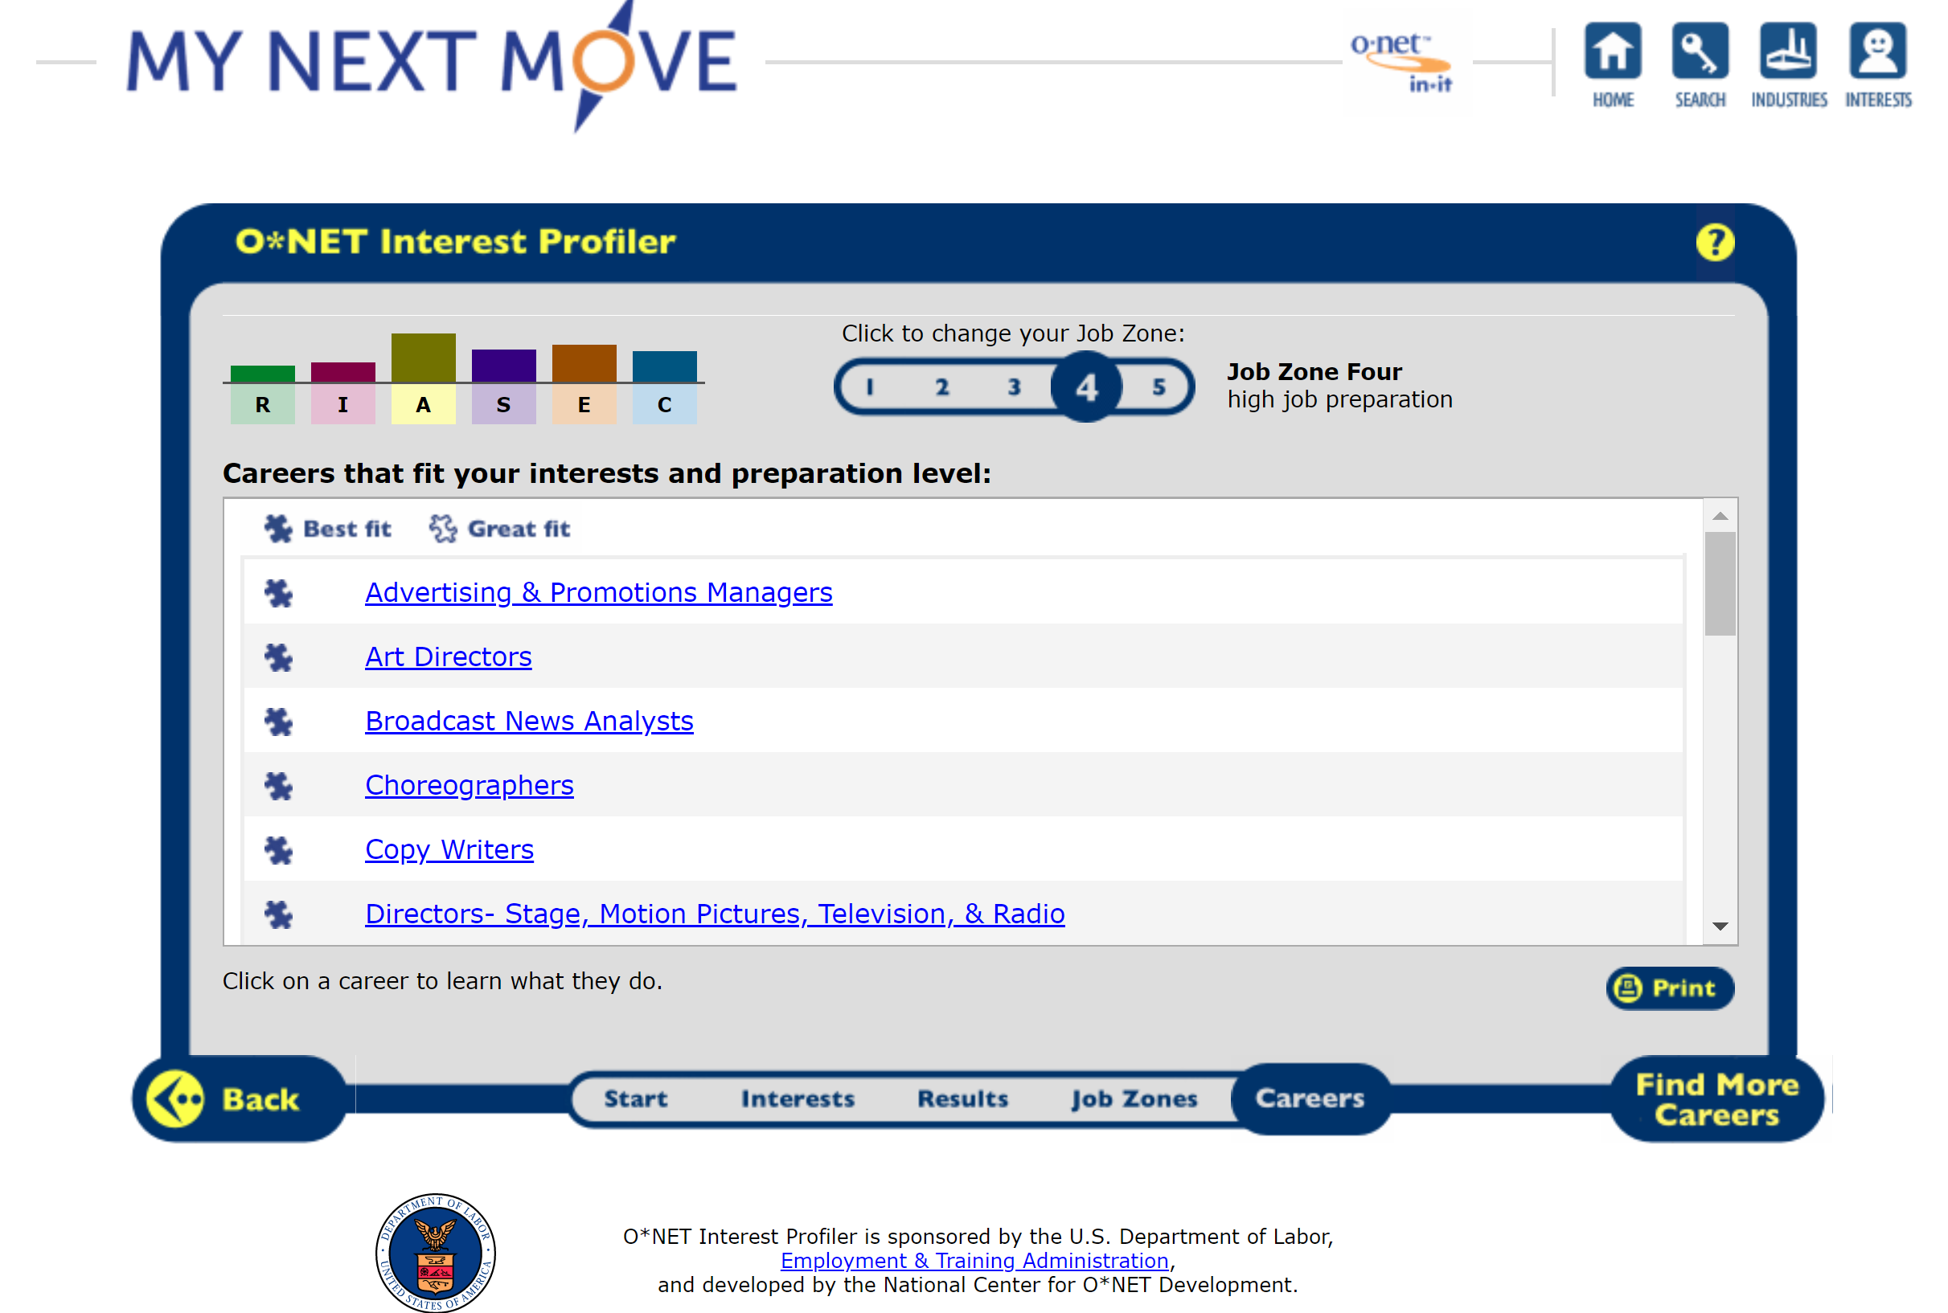
Choose ONE Dream Job

Slide 21
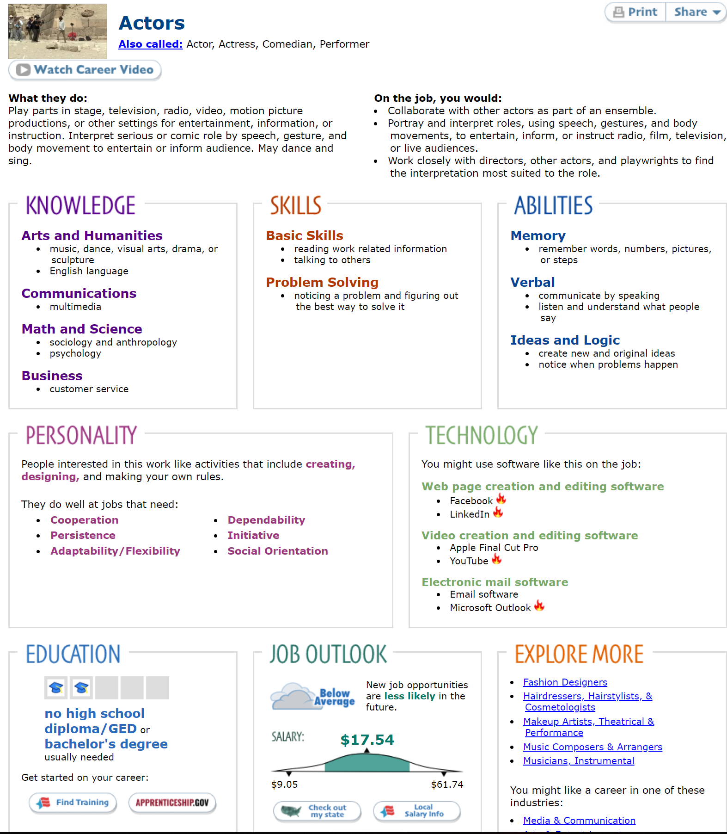
Save Your Job Info Page for the Next Step

Slide 22
Writing a Reflection
Take notes as you read the article.
Reflection Writing Article: https://www.wikihow.com/Write-a-Reflection-Paper

Slide 23
Reflection Example
During the O*Net personality quiz, I learned many things about my personality and the different jobs that would be best for me. My highest scoring personality was the “Realistic” personality. This means that I would do great in a job that is hands-on. For example, I could work with animals, machinery or a job that is outside.
For the Job Zone part of the quiz, I chose Zone Two because I have not really had previous experience with working in a “hands-on” job. After choosing this Zone, the results showed lots of jobs. The one I found the most interesting was a Pet Groomer. The job I found the most surprising was a Non-venomous Reptile Handler.
Although these jobs sound fun, I do not think they are the right fit for me. I don’t think I would do well with dogs because I have allergies and snakes scare me. I think that it would be better to go back and look at other “hands-on” jobs that do not involve animals.
This resource has helped me learn more about career opportunities by giving me jobs that are based on my interests and giving me information on those jobs. The website profiler was very thorough and gave me good information to help me decide that these were not the best jobs for me.

Slide 24
Step 2: Job Research
Key Words
Job Requirements
Type
Location
Pay/Salary
Degree
Certificate
Job Experience

Slide 25
Research the Job
Main Points:
Knowledge
Skills
Abilities
Personality
Technology
Education
Job Outlook
Explore More
Feel free to print or download the page. Either way take lots of notes!

Slide 26
Take Notes! Write down the info from O*NET
Name of Job:____________________________________________________
Type of Job:_____________________________________________________
Location of Job:__________________________________________________
Pay:___________________________________________________________
Education/Training/Certificates Required:____________________________________________________________
Job Experience Required:____________________________________________________________
3 Reasons you might want this job:__________________________________________________________________

Slide 27
Step 3: Educational Research
Key Words
Offerings
Barriers
Type of school: community college, university, vocational
Degree Programs
Tuition
Location
Availability/Proximity of Childcare
Public Transportation
Tutoring
Accredited
Reputation of School

Slide 28
Research Programs
Navigating school websites: Use the link below and read the article about understanding different college websites. https://www.campusexplorer.com/college-advice-tips/9555E375/How-Do-I-Find-The-Information-I-Need-On-These-Huge-College-Websites/
The following words are outlined in the article and will help you find the right information for just about any school website:
Prospective Students, Enrollment Requirements, Scholarships
The following websites are provided for easy use:
School 1:Cal State University San Bernadino https://www.csusb.edu/
School 2: Mira Costa College http://miracosta.edu/index.html

Slide 29
Research the Education Programs
Find 2 schools that offer programs to help prepare you for your job in Step 2. Write the information you find on your Notes Sheet under Step 3.
Use the schools from the last slide OR from your Interest Profiler Results in Step 1:

Slide 30
Choose 6 “Offerings” to Compare
Type of school (community college, university, vocational)
Ability to get a class/start date
Admission requirements
Tuition/Cost
Financial Aid
Location
Availability/Proximity of childcare
Public transportation
Tutoring
Accredited
Reputation of school

Slide 31
Compare the Offerings and Barriers
 | School 1 Offerings (from list above) | School 1 Barriers | School 2 Offerings (from list above) | School 2 Barriers
Comparison 1
Comparison 2
Comparison 3
Comparison 4
Comparison 5
Comparison 6

Slide 32
Step 4: Work Sample & Reflection
Key Words
Sample
Reflect/Reflection
Prepare
Understanding
Reasoning

Slide 33
Final Step!
Pick one of your Notes sheets and staple it to the back of your packet.
Explain why you chose it
Answer the 3 YES/NO questions
Do you believe the Interest Profiler is true to your personality? YES/NO
Do you have a better understanding of career requirements (Job Zones)? YES/NO
Do you feel better prepared for researching future jobs and/or secondary education? YES/NO

