Slide 1
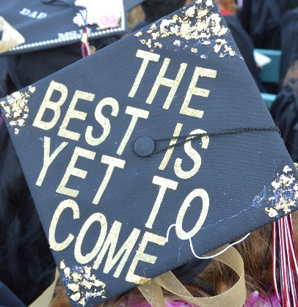
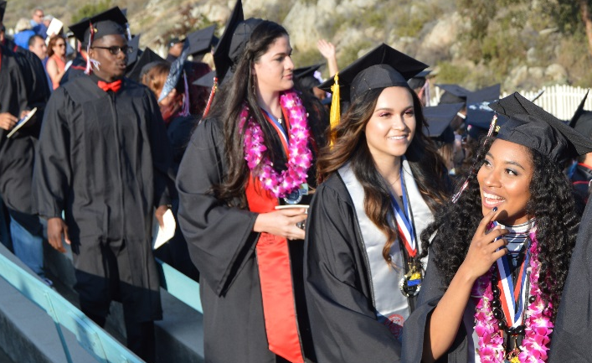
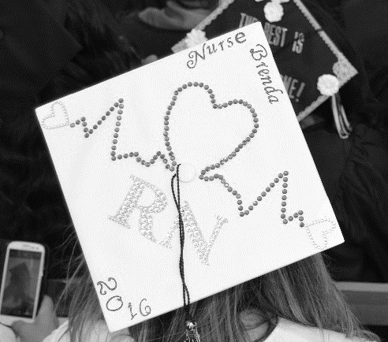
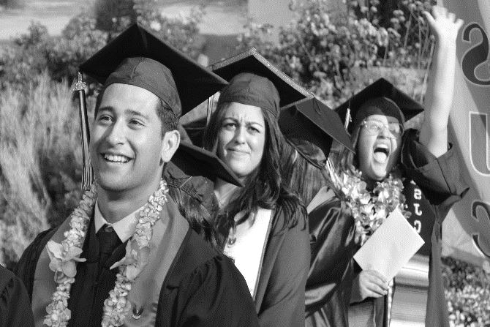

Mt. San Jacinto Community College District adopted Budget presentation
2016-2017
Board of Trustees Meeting
September 8, 2016

Slide 2
2016-2017 adopted Budget
Topics of Discussion
State Budget Summary
Ballot Measures
2016-2017 Advance Principle Apportionment
MSJC 2016-2017 Adopted Budget Assumptions
Measure AA Projects
Board of Trustees Meeting, September 8, 2016

Slide 3
State budget summary
2016-2017 Adopted budget
September 8, 2016

Slide 4
2016-2017 adopted Budget
State Budget Summary
The 2016-2017 State Budget was signed by the Governor on June 27, 2016
Focuses on one-time activities
  Repairing aged infrastructure
  Building affordable housing
  Address the effects of the drought
Begins implementation of raising state minimum wage to $15 per hour by providing funding for an increase to $10.50 per hour
Minimum Guarantee Funding for K-14 schools is $71.9 billion
Increases Rainy Day Fund to a total balance of $6.7 billion
Board of Trustees Meeting, September 8, 2016

Slide 5
2016-2017 adopted Budget
State Budget – Community Colleges
Programs | 2015-16 Enacted Budget | 2016-17 Enacted Budget | Change
Enrollment Growth | 156,457,000 | 114,668,000 | (41,789,000)
Cost of Living Adjustment (COLA) | 61,022,000 | - | (61,022,000)
Funding for Full-Time Faculty | 62,320,000 | - | (62,320,000)
Base Allocation Funding/Rate Increase | 266,692,000 | 75,000,000 | (191,692,000)
Property Tax Backfill | - | 31,695,000 | 31,695,000
Basic Skills | 20,037,000 | 50,037,000 | 30,000,000
Disabled Students | 115,388,000 | 115,388,000 | -
CalWORKs | 34,897,000 | 43,580,000 | 8,683,000
Student Success & Support Program (SSSP) | 471,683,000 | 481,683,000 | 10,000,000

Slide 6
2016-2017 adopted Budget
State Budget – Community Colleges
Programs | 2015-16 Enacted Budget | 2016-17 Enacted Budget | Change
Telecommunications and Technology Infrastructure
Data Security (TTIP) | 3,000,000 | 3,000,000 | -
Technology Infrastructure- 10 gig Circuits (TTIP) | 5,000,000 | 5,000,000 | -
Economic Development | 22,929,000 | 270,929,000 | 248,000,000
Strong Workforce Program | - | 200,000,000 | 200,000,000
Career Technical Education Pathways Program (CTE) | 48,000,000 | 48,000,000 | -
Extended Opportunity Programs and Services (EOPS) | 123,189,000 | 123,189,000 | -
Zero Textbook cost degree (one-time) | - | 5,000,000 | 5,000,000
Board of Trustees Meeting, September 8, 2016

Slide 7
2016-2017 adopted Budget
State Budget – Community Colleges
Programs | 2015-16 Enacted Budget | 2016-17 Enacted Budget | Change
Physical Plant and Instructional Support/ Deferred Maintenance | 148,000,000 | 184,565,000 | 36,565,000
Proposition 39 | 38,737,000 | 49,280,000 | 10,543,000
Full-time Student Success Grant | 39,000,000 | 41,174,000 | 2,174,000
Mandate Backlog Payments (one-time, per FTES) | 603,700,000 | 105,501,000 | (498,199,000)
Adult Education Block Grant Statewide Leadership Activities (one-time) | - | 5,000,000 | 5,000,000
Board of Trustees Meeting, September 8, 2016

Slide 8
Ballot Measures
2016-2017 Adopted budget
September 8, 2016

Slide 9
2016-2017 adopted Budget
Ballot Measures
Proposition 51 - School Bonds. Funding for K-12 School and Community College Facilities
Authorizes $9 billion in general obligation bonds:
  $3 billion for new construction & $3 billion for modernization of K-12 public school facilities;
  $1 billion for charter schools and vocational education facilities;
  $2 billion for California Community Colleges facilities.
Board of Trustees Meeting, September 8, 2016

Slide 10
2016-2017 adopted Budget
Ballot Measures
Proposition 55 - Tax Extension to Fund Education & Healthcare
Extends by twelve (12) years the temporary personal income tax increases enacted in 2012
  Earnings over $250,000 for single filers
  Earnings over $500,000 for joint filers
  Earnings over $340,000 for heads of household
Allocates tax revenues 89% to K-12 schools and 11% to California Community Colleges.
Allocates up to $2 billion per year in certain years for healthcare programs.
Board of Trustees Meeting, September 8, 2016

Slide 11
2016-2017 advanced apportionment
2016-2017 Adopted budget
September 8, 2016

Slide 12
2016-2017 Adopted Budget
Advanced Principal Apportionment
Funded/ Actual FTES
11,957.098
497.478
198.432
12,653.008
Base FTES
11,200.750
466.010
185.880
11,852.640
Growth FTES
756.348
31.467
12.552
800.368
Budgeted FTES -12,327
VII Total Computational Revenue: $69,208,260
A1-Property Taxes $26,216,088
B-Student Enrollment Fees $3,319,373
C-State General Apportionment $28,502,612
D-Estimated EPA $10,017,557
Available Revenue $68,718,284
E-Revenue Shortfall $489,976
Budgeted Growth Rate - 4%
A. Growth Rate 6.75%
Adopted Budget Revenue - $67,601,151

Slide 13
MSJC Budget assumptions
2016-2017 Adopted budget
September 8, 2016

Slide 14
2016-2017 adopted Budget
MSJC Budget – Revenue Assumptions
Enrollment Growth 2%
  4% Budgeted Growth Rate
  6.75% Targeted Growth Rate
Base Allocation Increase
Education Protection Account (Prop 30)
Mandate Backlog Reimbursement
Physical Plant and Instruction Equipment Funding
No COLA
Board of Trustees Meeting, September 8, 2016

Slide 15
2016-2017 adopted Budget
MSJC Budget – Expenditure Assumptions
13 net new teaching Faculty
3 Replacement Faculty – due to retirement/resignation
Increase to STRS/PERS employer contribution rates
7% Board Reserve
Collective Bargaining Settlements
Enrollment Targets – Section Increases
4% increase to Divisions’ Discretionary Funds
Board of Trustees Meeting, September 8, 2016

Slide 16
MSJC Budget – Budget Allocation Model
Unrestricted General Fund - Unaudited
Revenue |  |  |  |  | Adopted Budget 16/17
 |  | Net additional Unbudgeted Revenue over Expense |  |  | $ 10,195,179
 |  | Unused Categorical Program Interfund Transfer |  |  | -
 |  | Budgeted Ending Balance 6/30/16 |  |  | 300,000
 |  | Unaudited Beginning Balance 7/1/2016 |  |  | $ 10,495,179
 |  | Actual Revenue FY 2016-2017 |  |  | 75,419,595
 |  | Total Anticipated Revenue |  |  | 85,914,774
Notes
1. | Less, Unrestricted Reserve |  | (300,000)
2. | Less, Intrafund Transfer to Student Financial Services |  | (85,000)
3. | Less, Interfund Transfer to Childcare |  | (164,204)
4. | Less, Intrafund Transfer to Block Grant |  | (270,587)
5. | Less, Unrestricted Reserve transfer to 7% reserve |  | (1,041,910)
6. | Less, Interfund Transfer to Self Insurance |  | (388,000)
7. | Less, Interfund Transfer to Capital Outlay |  | (850,000)
 |  |  |  |  | (3,099,701)
 |  | Total Available Funds for Allocation (TAFA) |  |  | $ 82,815,073
Allocation Increment
1. | PY Base Expenditure Budget (2015-2016) |  |  |  | $ 77,096,777
2. | CY TAFA (2016-2017) |  |  |  | 82,815,073
3. | Allocation Increment (A.I.) |  |  |  | 5,718,296
4. | 2016-2017 Base Budget Adjustments |  | (5,718,296)
 |  | Remaining Allocation Increment |  |  | $ -

Slide 17
2016-2017 Adopted Budget
MSJC Budget – Budget Allocation Model
Expenditures |  |  |  | President |  | Instruction | Student Services | Business Services | Human Resources | Total
 | FY 2015-2016 Base Expenditure Budget (1000-6XXX) |  |  | $11,578,912 |  | $40,215,775 | $9,377,077 | $14,560,837 | $1,364,176 | $77,096,777
 | P | 2016-2017 Base Budget Adjustments |  | 453,485 (1) |  | 4,938,227 | 1,943,476 | 2,911,709 | 194,747 | 10,441,644
 | O | FY 2015-2016 PERS/STRS/OPEB Reserve moved to object 7920 |  | (5,814,850) |  | - | - | - | - | (5,814,850)
 | O | Additional PERS/STRS Reserve |  | 1,091,502 |  | - | - | - | - | 1,091,502
 | Base Expenditure Budget for FY 2016-2017 (1000-6XXX) |  |  | $7,309,049 |  | $45,154,002 | $11,320,553 | $17,472,546 | $1,558,923 | $82,815,073
Notes:
(1) Includes Resource Allocation Proposal reserve transferred to other divisions
 |  | P | Permanent Base Ongoing Funding |  | 4,626,794
 |  | O | One Time Funding |  | 1,091,502
 |  |  |  |  | 5,718,296

Slide 18
2016-2017 adopted Budget
MSJC Budget – Budget Allocation Model
 |  |  | San Jacinto Campus (2) | Menifee Valley Campus | Temecula Campuses | San Gorgonio Campus | District Wide (3) | Total
 | Base Expenditure Budget for Fiscal Year 2016-2017 (1000-6XXX) |  | $34,131,450 | $30,140,860 | $1,726,986 | $459,338 | $16,356,439 | $82,815,073
(2) Includes Administration Expenditures (3) Includes Associate Faculty Budget
Board of Trustees Meeting, September 8, 2016

Slide 19
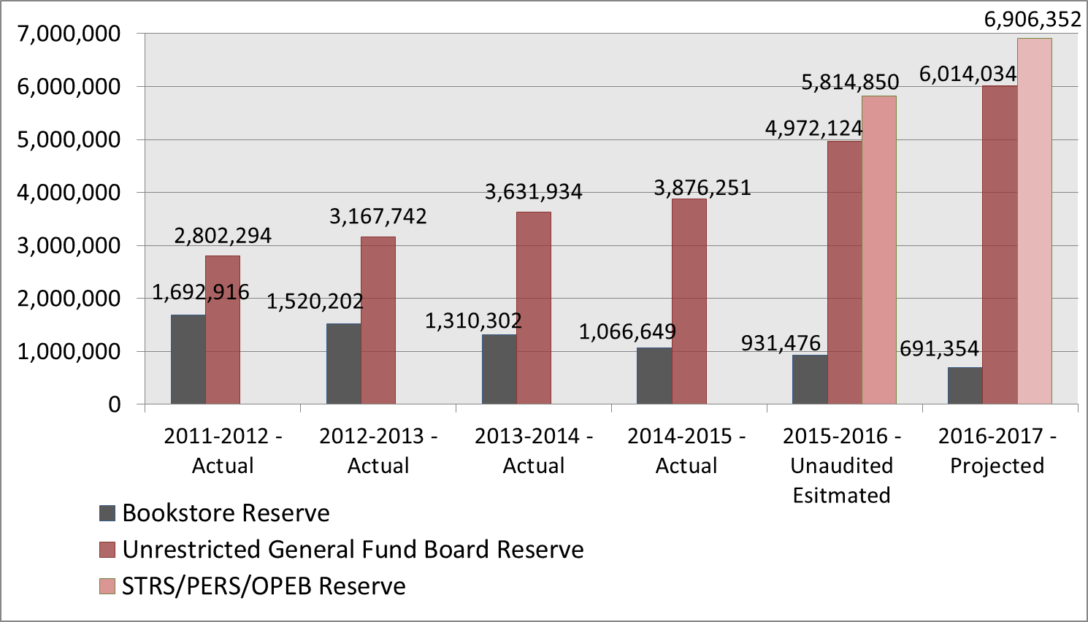
2016-2017 adopted Budget
MSJC Budget – Unrestricted General Fund Reserves

Slide 20
2016-2017 Adopted Budget
Other Post Employment Benefits (OPEB) Trust*
Total
Active Employees Liability: | $5,376,848
Retired Employees Liability: | $1,851,439
Total Accrued Liability: | $7,228,287
Unamortized Unfunded Actuarial Accrued Liability (UAAL)* | $3,284,969
Irrevocable Trust Assets (at August 16, 2016): | $3,852,209
Subtotal (Funded Liability): | $7,137,178
Residual UAAL (District’s Unfunded Liability) | $91,109**
*As of the June 30, 2015 OPEB Actuarial Study.
**Funds are budgeted to eliminate the Residual UAAL.
The next Actuarial Study will take place in July 2017.
Board of Trustees Meeting, September 8, 2016

Slide 21
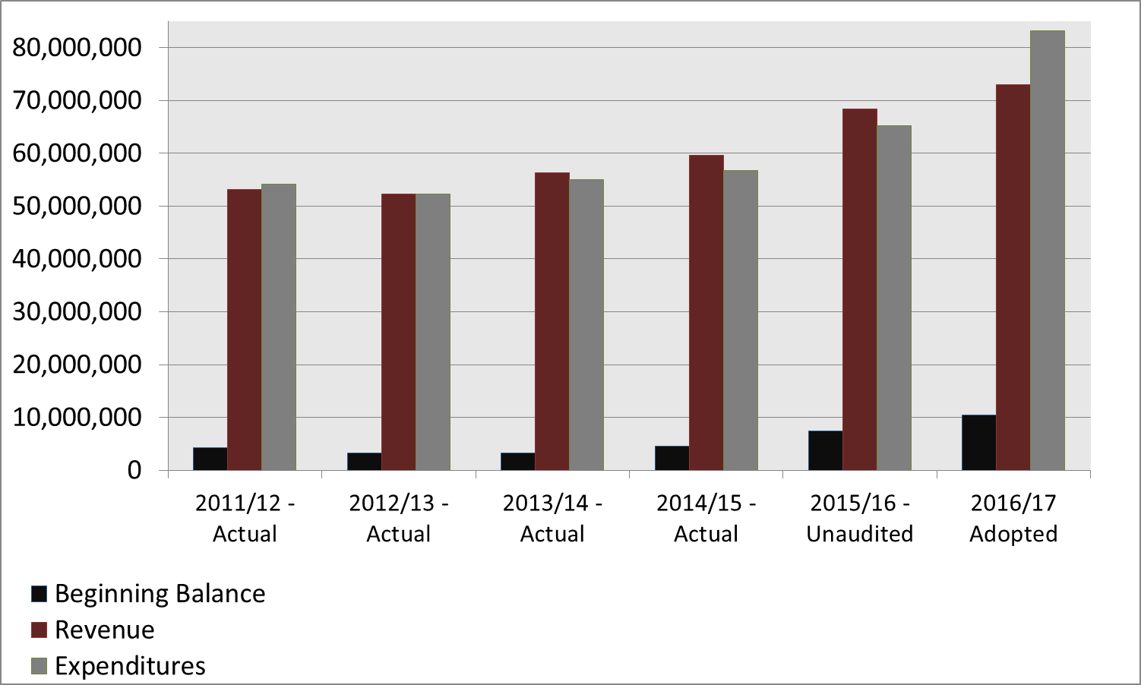
2016-2017 adopted Budget
MSJC Budget – Historical Data – Revenue vs. Expenditures
NOTE: Deficit spending in the Budgeted year is due to inclusion of the beginning balance and zero base budgeting.

Slide 22
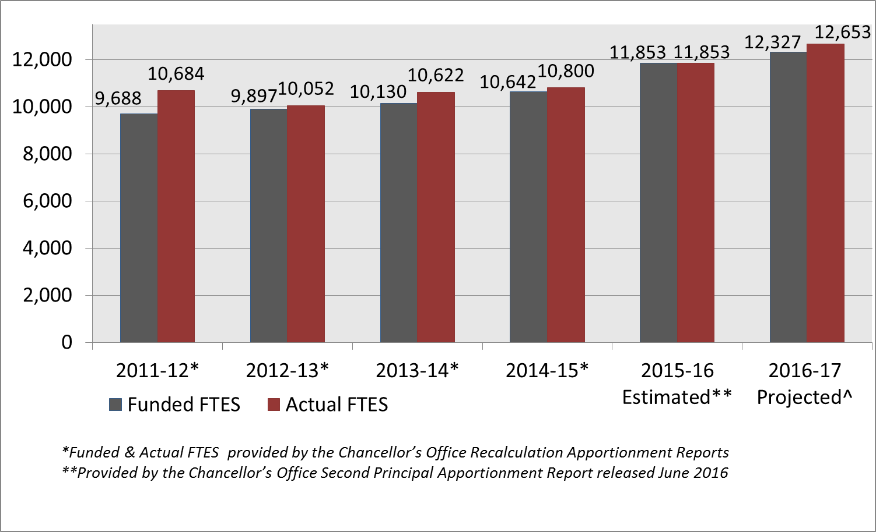
2016-2017 adoptive Budget
MSJC Budget – Historical Data – FTES Comparisons
^Projected Funded FTES based on budgeted 4% growth, Projected Actual FTES is based on District’s 6.75% growth rate, per the Advance Principal Apportionment released August 2016.

Slide 23
Measure AA Bond Projects
2016-2017 Adopted budget
September 8, 2016

Slide 24
2016-2017 adopted Budget
Measure AA – Series A
 |  | 2015-2016 |  | 2016-2017
 |  | Actual |  | Adopted
BEGINNING FUND BALANCE |  | $62,929,359 |  | $54,781,961
REVENUES
1. | Interest | 291,193 |  | 200,000
TOTAL REVENUES |  | 291,193 |  | 200,000
TOTAL BEGINNING BALANCE AND REVENUES |  | $63,220,552 |  | $54,981,961
EXPENDITURES
1. | District - Athletics Facilities Renovation | 201,587 |  | 3,000,000
2. | District - Blue Light Help Phones | - |  | 626,000
3. | District - Building Security Access Control | 38,900 |  | 1,000,000
4. | District - CDEC Security Enhancements | 12,499 |  | 1,410,000
5. | District - Classroom Phones | - |  | 250,000
6. | District - EIR/CEQA | 593,886 |  | 500,000
7. | District - Fiber Re-Capitalization (Technology) | - |  | 500,000
8. | District - Infrastructure Master Plan | 200,672 |  | 320,000
9. | District - Lease Revenue Bond (LRB) | 5,874,112 |  | -
10. | District - Miscellaneous Planning and Bond Management Expenses | 196,485 |  | 915,835
11. | District - Network and Control Switches Upgrades | 148,636 |  | 1,110,000
12. | District - Parking Lot Expansion | - |  | 1,600,000
13. | District - Planning | 609,493 |  | 408,507
14. | District - Shade Structure Projects | - |  | 800,000
15. | District - Signage & Wayfinding | - |  | 500,000
16. | District - Solar Photovoltaic System | 21,718 |  | 4,000,000

Slide 25
2016-2017 adopted Budget
Measure AA – Series A
2015-2016 |  | 2016-2017
Actual |  | Adopted
17. | District - Video Conferencing Upgrades | 322,697 |  | 20,000
18. | District - Video Security Enhancements (Cameras and Media Storage) | - |  | 250,000
19. | District - Wireless Deployment | 34,524 |  | 1,121,300
20. | MVC - Building 900 Feasibility Study | - |  | 24,000
21. | MVC - Building 300 Renovation | 68,978 |  | 105,000
22. | MVC - Building 3000 Rehabilitation/Fiber Installation | 67,103 |  | 1,079,000
23. | MVC - Emergency Generator | 16,075 |  | 175,000
24. | MVC - Facilities/M&O Building | - |  | 100,000
25. | MVC - Infrastructure Projects | - |  | 175,000
26. | MVC - Music Building 200 Renovation | - |  | 500,000
27. | MVC - Science Labs & Classroom Modular Swing Space | 284 |  | 2,926,100
28. | SGP - New Center Template | - |  | 470,000
29. | SGP - Science Labs & Classroom Modular Swing Space | 284 |  | 278,583
30. | SJC - Building 200 Safety Improvements | 14,300 |  | 1,700,000
31 | SJC - Emergency Generator | 16,074 |  | 400,000
32. | SJC - Infrastructure Projects | - |  | 175,000
33. | SJC - Science Labs & Classroom Modular Swing Space | 284 |  | 418,000
34. | SJC - STEM Building | - |  | 500,000
35. | Wildomar - New Center Template | - |  | 420,000
TOTAL EXPENDITURES |  | 8,438,591 |  | 27,777,325
ENDING FUND BALANCE |  | $54,781,961 |  | $27,204,636
TOTAL EXPENDITURES AND ENDING FUND BALANCE |  | $63,220,552 |  | $54,981,961

Slide 26
2016-2017 Adopted Budget
Budget Development Committee
Administration | Faculty | Classified | Student Government
Becky Elam Co-Chair | Michael Welden, Co-Chair | Jennifer Pickens | Michael Bohm
William Vincent | Nizam Kazi | Diane Morales
Rudolph Besikof | Rosaleen Gibbons | Jeanne Maggard
Julie Venable
 |  | Resources: Paul Hert Gail Jensen | Rebecca Teague Jennifer Marrs
Board of Trustees Meeting, September 8, 2016

Slide 27

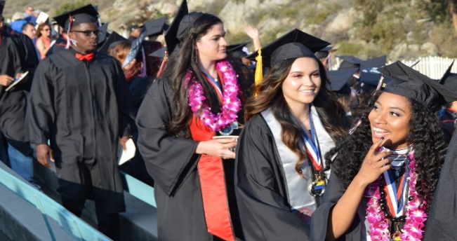


Questions?
2016-2017 Adopted Budget
Board of Trustees Meeting
September 8, 2016

