Slide 1
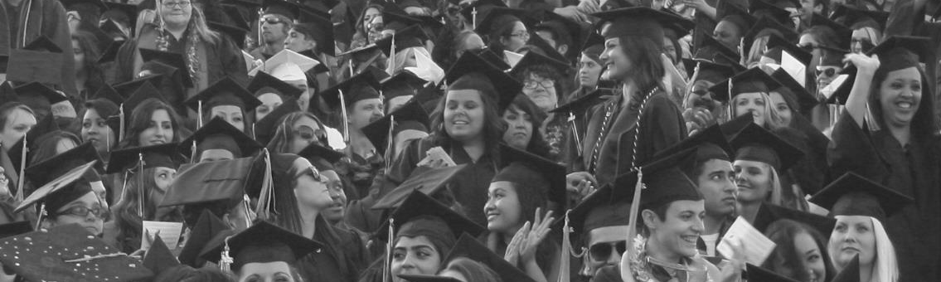

Mt. San Jacinto Community College District
Five Year Construction Plan
Board of Trustees Meeting
June 25, 2015

Slide 2
Mt. San Jacinto College District
Five Year Construction Plan
Topics of Discussion
  District 5-Year Construction Plan
  Cost Components of Construction

Slide 3
Five Year Plan

Slide 4
Mt. San Jacinto College District
Five Year Plan
Government Code §§ 13100-13102 require the Governor to annually submit a five-year capital infrastructure plan to the Legislature in conjunction with the Governor's Budget.
To accomplish this, every entity of state government is required to provide to the Department of Finance (DOF) information related to capital infrastructure needs and costs for a five-year period.
Additionally, Education Code §§ 67501 and 67503 require the California Community Colleges Chancellor's Office to prepare a five-year capital outlay plan identifying the statewide needs and priorities of the California Community Colleges.
Source: 2015-2016 Chancellor’s Office Five Year Capital Outlay Plan

Slide 5
Five Year Construction Plan
State Capital Outlay
Proposals for the 2016-17 (submitted July 2014) and 2017-18 fiscal years will be evaluated as part of a two-year state capital outlay program
  Limit of one project per campus for the two years.
The 2016-17 draft spending plan was submitted to the Board of Governors for approval in May
  Spending plan includes 18 projects totaling approximately $500 million
The 2017-18 spending plan will be developed using a “zero-based” budgeting method
Board of Trustees Meeting – June 25, 2015

Slide 6
Mt. San Jacinto College District
Five Year Construction Plan - As of July 2015
Project | Type | Campus | Status | Total Cost of Project | State Contribution | District Match
Science & Technology Building | B | San Jacinto | FPP Submitted | $33,167,000 | $16,585,000 | $16,582,000
Math & Science Building | B | Menifee | FPP Approved- Not Funded | $44,764,000 | $22,537,000 | $22,227,000
Cultural Arts Center | D1 | San Jacinto | IPP Submitted | $47,036,000 | $23,518,000 | $23,518,000
Student Services Building | E | Menifee | IPP Submitted | $21,808,000 | $10,904,000 | $10,904,000
Allied Health Building | B | Menifee | IPP Submitted | $13,042,000 | $6,521,000 | $6,521,000
Board of Trustees Meeting – June 25, 2015

Slide 7
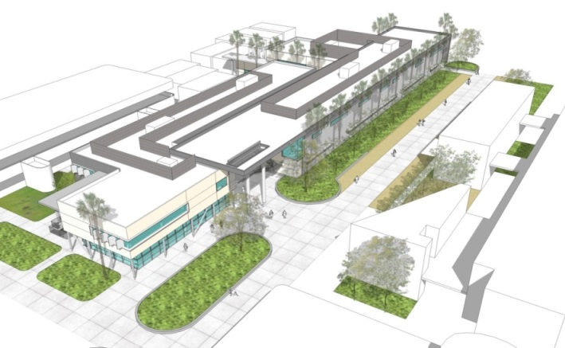
Mt. San Jacinto College District
Five Year Plan
Final Project Proposals
Menifee Campus
  Math & Science Building – FPP Approved – Not Funded
    1,950 Net FTES Increase
    7,931 ASF in Lecture Rooms
    27,845 ASF in Labs
    Programs include Math, Anatomy & Physiology, Bio Technology, Chemistry, Organic Chemistry, Microbiology, Biology, Astronomy, Physics & Geology
Board of Trustees Meeting – June 25, 2015

Slide 8
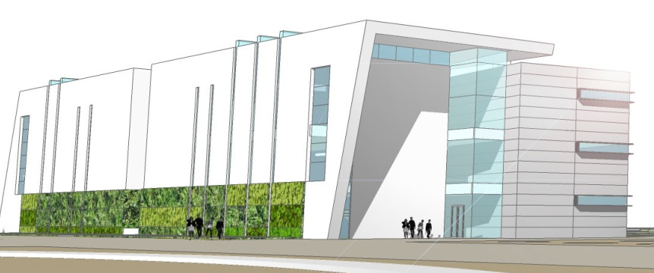
Mt. San Jacinto College District
Five Year Plan
Final Project Proposals
San Jacinto Campus
  Fire Alarm Systems – FPP Approved & Funded
    Allocation for Preliminary Plans and Working Drawings released in 2014/2015 fiscal year (one of only eight projects funded)
  Science & Technology Building – FPP Submitted
    940 Net FTES Increase
    36,922 ASF
    6,544 ASF in Lecture Rooms
    23,199 ASF in Labs
    General Classrooms, Biology Labs, Physical Sciences Labs, Math Labs, General Study Labs and Faculty Offices.
Board of Trustees Meeting – June 25, 2015

Slide 9
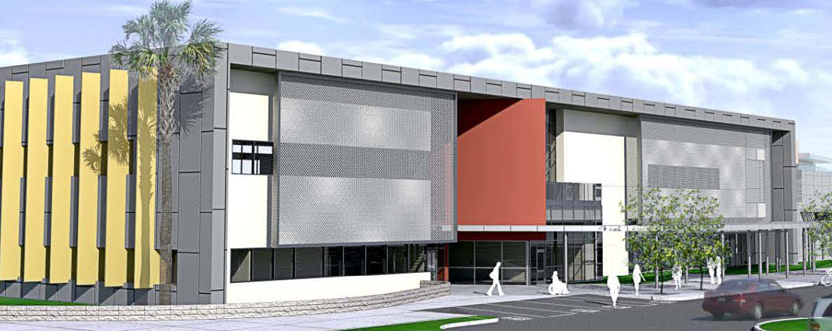
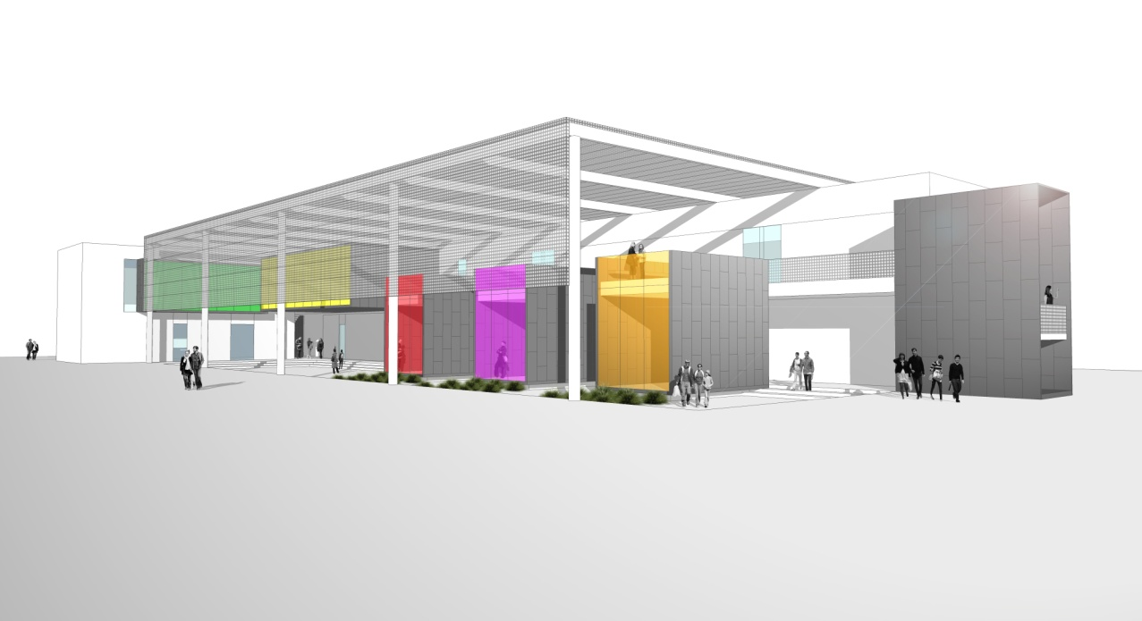
Mt. San Jacinto College District
Five Year Plan
Initial Project Proposal
Menifee Campus
  Student Services Building
    72 Net FTES Increase
    Centralization of Student Services, including EOPS, DSPS, Enrollment Services, Financial Aid, Assessment & Testing, Counseling, Veterans and International Affairs.
  Allied Health Building
    756 Net FTES Increase
    The Nursing & Allied Health Program have outgrown their current building. This building will allow the Department to expand current programs and develop new programs
Board of Trustees Meeting – June 25, 2015

Slide 10
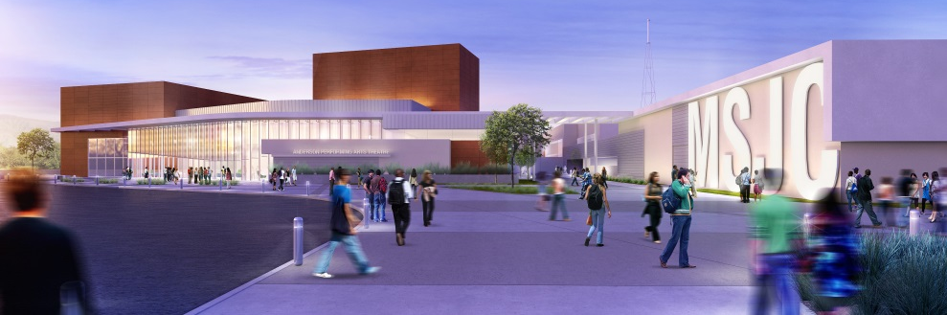
Mt. San Jacinto College District
Five Year Plan
Initial Project Proposal
San Jacinto Campus
  Cultural Arts Center
    1030 Net FTES Increase
    General Classrooms, Computer Lab, Video Production Lab, Recording Studios, Radio & TV Studio, Post Production Lab, Painting Lab, 3D & 2D Studio, Ceramics Labs, Dance Labs, Dance Theater, Scene Shop, Costume Shop, Art Gallery, 400 Seat Theater
Board of Trustees Meeting – June 25, 2015

Slide 11
  Cost Components of Construction

Slide 12
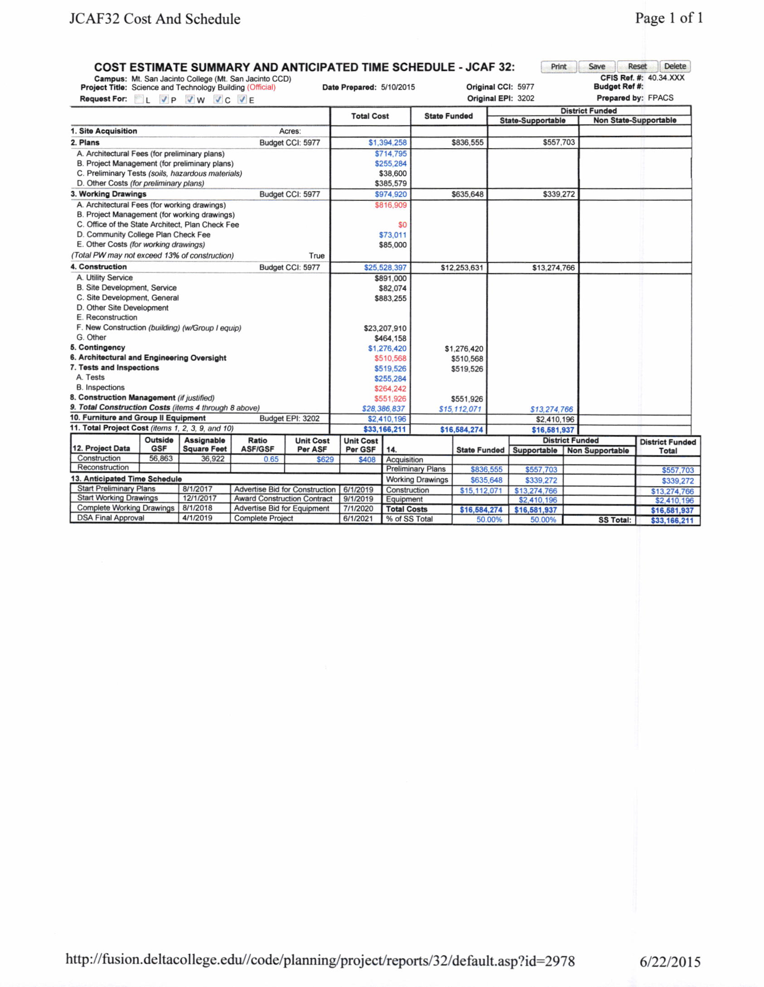

Slide 13
Mt. San Jacinto College District
JCAF 32
Square Footage Construction Cost based on Line F

Slide 14
Mt. San Jacinto College District
Chancellor’s Office Allowable Fees
Chancellor’s Office funds architectural fees at 8 percent of total construction costs for new construction and 10 percent for remodeled spaces. The fee is broken down into three components:
  Thirty-five (35) percent of the architect's fee is for preliminary plans (design development),
  Forty (40) percent of the fee is for working drawings (contract documents),
  Twenty-five (25) percent is for architectural oversight during construction of the project,
  Project management (1% of construction costs) and special consultant fees (1% of construction costs) are also allowable when appropriate.
*Source: Facilities Planning Manual, Part C
Board of Trustees Meeting – June 25, 2015

Slide 15
Mt. San Jacinto College District
Chancellor’s Office Allowable Fees
Construction-Related Allowances and Fees*
In addition to estimates of site development, infrastructure and building construction costs, the following add-on costs should be included in the estimate:
1. Contingency - 5% of construction contract costs for new projects or 7% for reconstruction projects.
2. Tests - 1% of construction costs.
3. Inspection - $12,166 per month.**
4. Construction Management - 2% of contract amount.
*Source: Facilities Planning Manual, Part C
**Source: Chancellor’s Office Construction Plan Memorandum
Board of Trustees Meeting – June 25, 2015

Slide 16
Mt. San Jacinto College District
Chancellor’s Office Allowable Fees
The Division of the State Architect's (DSA) plan check fee is allowable. The DSA charges 0.7% (.007) of the first $1,000,000 in construction costs plus 0.5% (.005) of costs over $1,000,000. The minimum fee is $250.
The plan check fee for the physically handicapped (Government Code, section 4454) should be added to DSA plan check fee. The minimum fee shall be $200.
*Source: Facilities Planning Manual, Part C
Board of Trustees Meeting – June 25, 2015

Slide 17
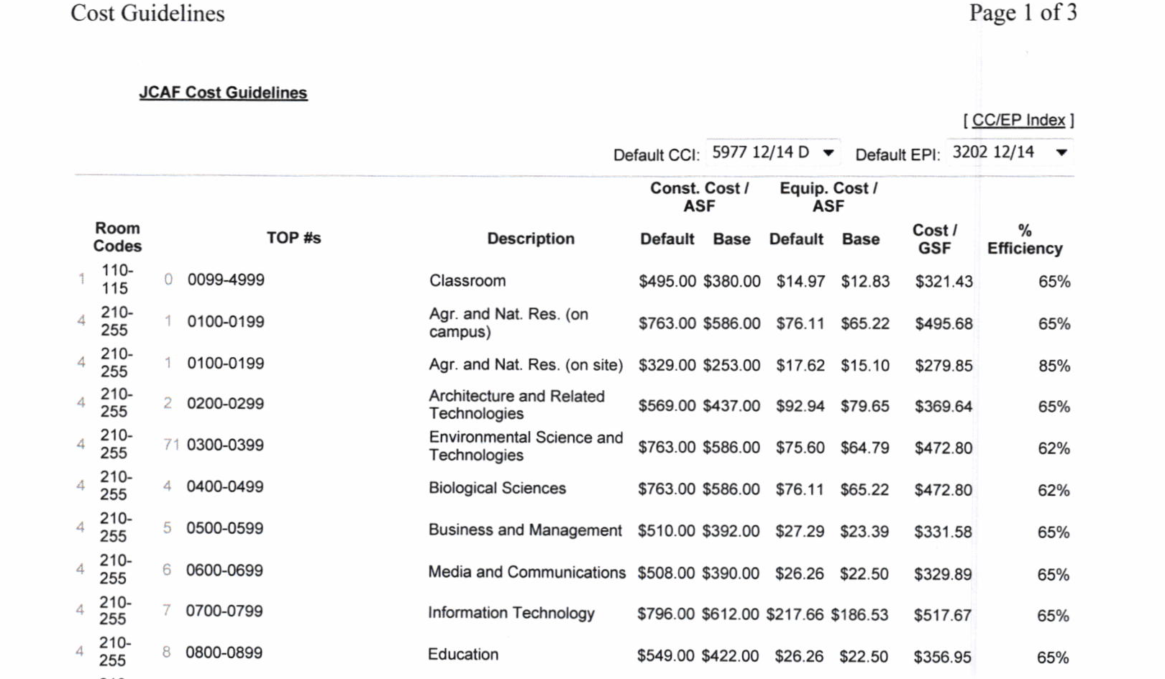
Mt. San Jacinto Community College
JCAF Cost Guidelines
Source: Fusion eManual
Board of Trustees Meeting – June 25, 2015

Slide 18
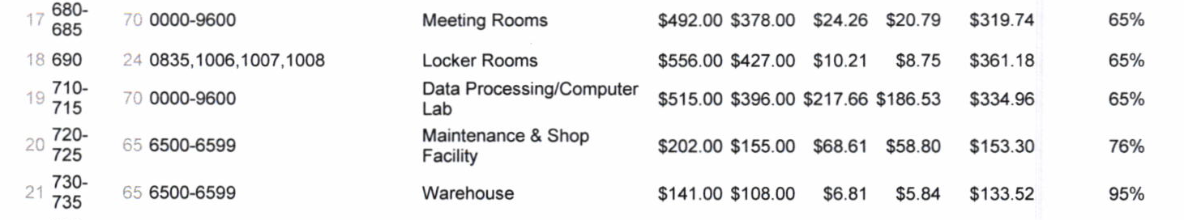
Mt. San Jacinto Community College
JCAF Cost Guidelines
Source: Fusion eManual
Board of Trustees Meeting – June 25, 2015

Slide 19
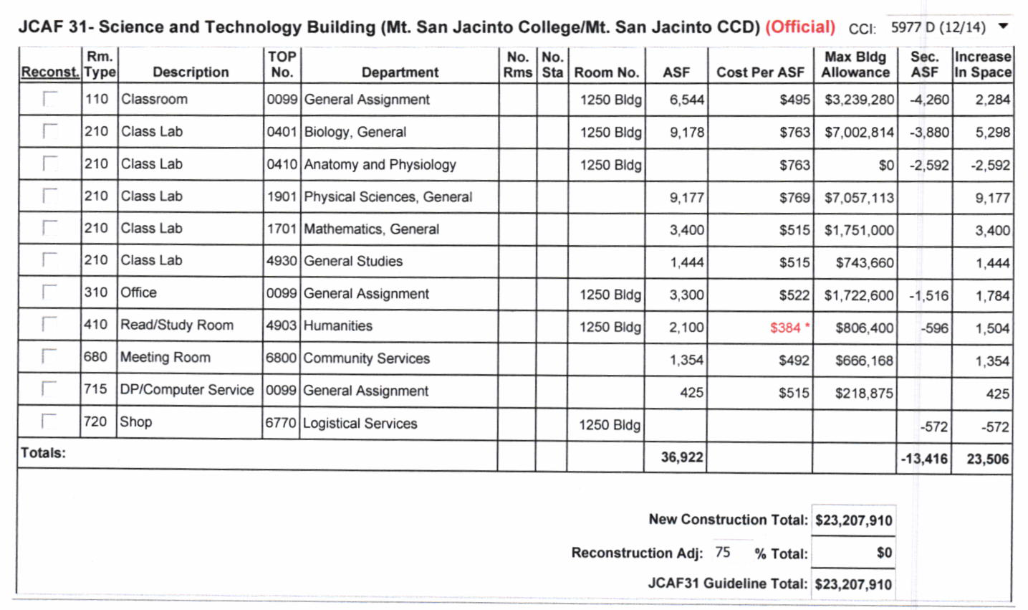
Mt. San Jacinto College District
Chancellor’s Office Allowable Fees
Source: Fusion

Slide 20
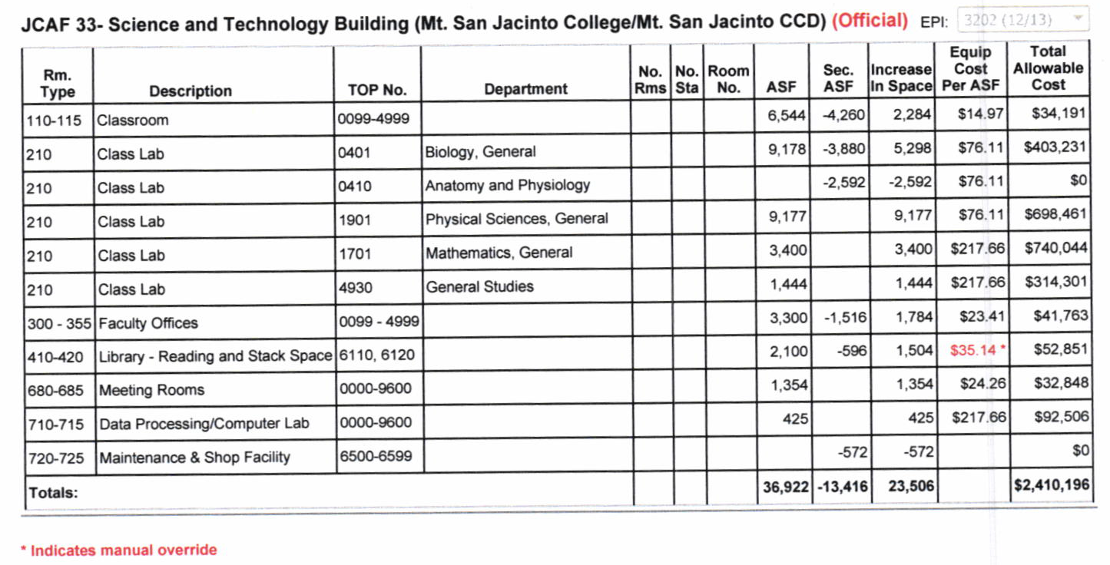
Mt. San Jacinto College District
Group II
Source: Fusion
Board of Trustees Meeting – June 25, 2015

Slide 21
Mt. San Jacinto College District
Five Year Plan
Questions?

