Slide 1


Basic First Aid
How to prepare and how to help
Notes:
Disclaimer: This information is not intended as a substitute for professional medical advice, emergency treatment or formal first-aid training. Don't use this information to diagnose or develop a treatment plan for a health problem or disease without consulting a qualified health care provider. If you're in a life-threatening or emergency medical situation, seek medical assistance immediately.

Slide 2

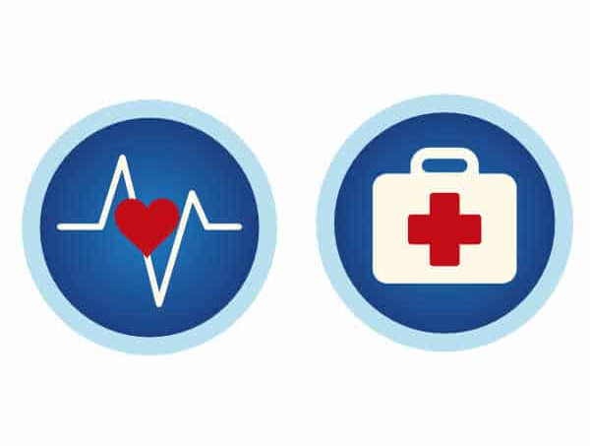
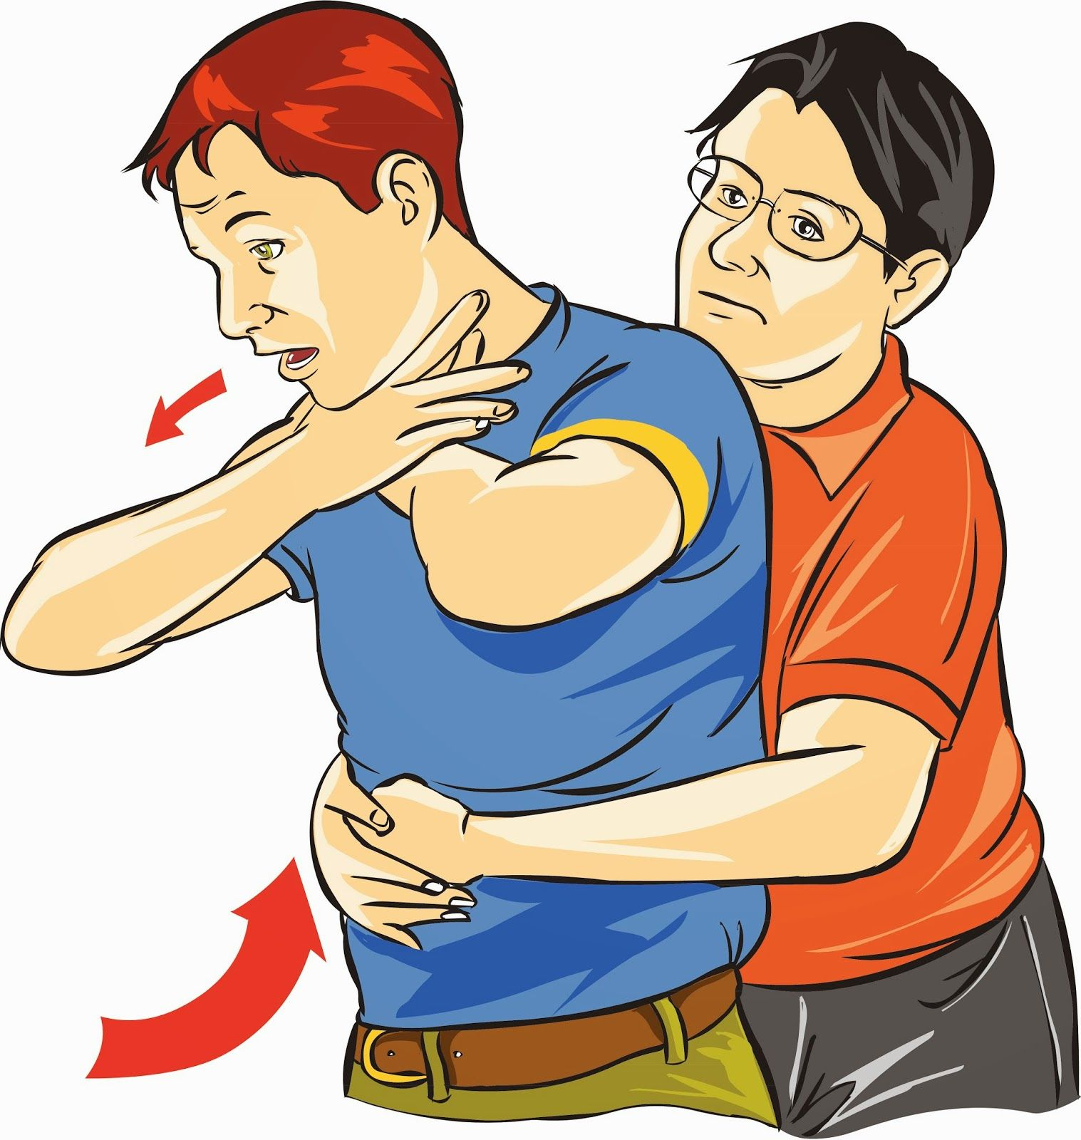
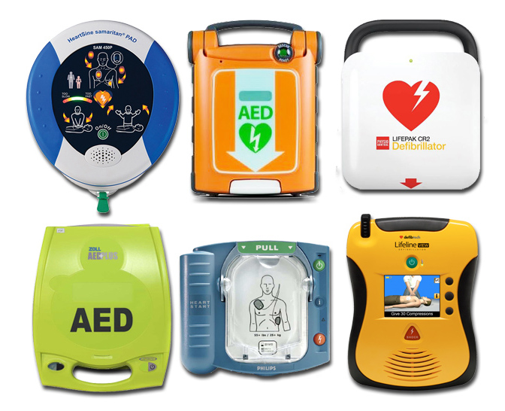
Take a CPR class
Learn the basics of the ABC’s
  Airway
  Breathing
  Circulation
  How to help someone who is choking
  How to use and AED(Automated External Defibrillator)
Notes:
Im not going to talk about the actual teachings of cpr during this presentation- however, I strongly suggest that everyone take a cpr class. Most are being offered online right now.

Slide 3
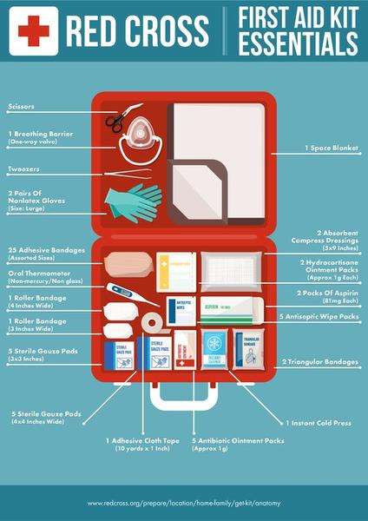
What should be in your first aid kit?
Whether you make or buy one, it should contain these items ( you can add a variety of others):
  Band-Aids
  Roll gauze
  Tape
  Mask for CPR
  Cold packs-breakable
  Antibiotic cream (like Neosporin)
  Gloves
  Scissors
  Antiseptic wipes
Notes:
Heres an example of one put together by the red cross. It includes the items listed-they added a space blanket, a thermometer, asprin and additional gauze bandages. Other include a flashlight, other medications like Benadryl and things like twezers and ace wraps. First aid kits are good to keep in your car and have in your house. Also, if you go camping, hiking.

Slide 4
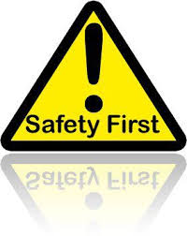
Scene Safety
ALWAYS check the scene to make sure it is safe for you to provide help
  You won’t be of any help if you get injured too!
  Is there water that the injured person is laying in? or is the person in a place that is dangerous to get to?(like down a steep hill or cliff)
  Downed power lines?
  Is there traffic?
  Is there a fire? Or a chance of an explosion?
Notes:
If the answer is yes to any of these questions, it may be best to wait for EMS(emergency medical services) Always call 911 before and dispatch will help instruct you on what to do

Slide 5
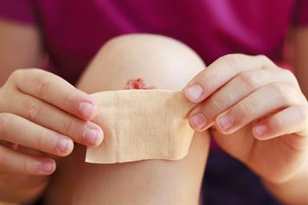
How to treat common minor injuries (or how to help until Professional help arrives)
Cuts and scrapes:
bleeding should stop on its own. Gentle pressure of a clean cloth can be used as needed until bleeding stops.
Rinse the wound with water and wash around it with soap.
Remove any dirt or debris.
You can choose to apply and antibiotic ointment
cover with a band-aid
monitor for signs of infection-increased redness, swelling, warm to the touch, fever, drainage(puss like) from wound
Notes:
I cant stress this enough, that these are tips on how to treat minor injuries or until emergency personnel get to the scene or until the person is able to seek medical attention. As we proceed with the slides-Always call 911 as soon as possible, or if less extreme, take them to the emergency room for more life threatening situations .

Slide 6
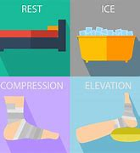
sprains
Sprains: think RICE:
REST-stay off of injury initially
ICE-as soon as possible for 15-20 min at a time
COMPRESS- an ace wrap in commonly used because it has elastic and provides support without being too tight
ELEVATE- keep above heart level to help with swelling.
For more severe sprains-seek further medical attention

Slide 7
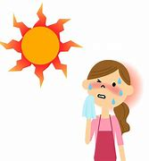
Heat exhaustion
Heat exhaustion: can happen after working or playing in the heat, being dehydrated and/or sweating a lot. Symptoms may include nausea, headache, dizziness, feeling faint, fatigue.
How to help:
Move the person into a cool and/or shaded area
lay them down and elevate the legs
remove any extra clothing, including shoes & socks
Have person drink water or anything without alcohol or caffeine.
Give the give the person a cool cloth for forehead, back of neck and armpits
Watch for heat stroke-which is life threatening and call 911 if you suspect.
Notes:
Placing these cloths in these areas will help them cool off faster.
Heat stroke-If the person is unable to drink, passes out or starts to become confused or has a seizure

Slide 8
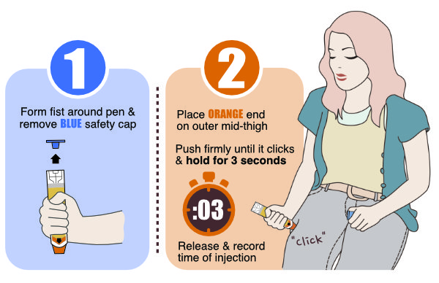
Burns and allergic reactions
Burns:
remove any jewelry or other tight clothing items as swelling may occur, place a cool, damp cloth over the burn-loosely
A minor burn is less than 3 in, is red(similar to a sunburn), develops a blister(do not pop blister, it helps protect against infection)
Allergic reactions(anaphylaxis):
symptoms like hives, itching, swelling of the face/lips/throat/tongue, wheezing or trouble breathing. Call 911. ask the person experiencing the symptoms if they have an epi pen. If they have an epi pen, it can be injected into the thigh
Notes:
Major-the burn is deep, greater that 3 in , are deep and may have areas that are black, white or brown
For major burns, call 911 and let the paramedics take over. With the allergic reaction-still call 911, even if the person is feeling better. Especially if an epi pen was used, they will likely need further evaluation and monitoring. The image is an example of what an epi pen can look like, there are others that look a little different. But the image gives you a good idea of how to use an epi pen

Slide 9
references
Anaphylaxis. Merck Manual Professional. Version. http://www.merckmanuals.com/professional/immunology-allergic-disorders/allergic,-autoimmune,-and-other-hypersensitivity-disorders/anaphylaxis. Accessed Jul. 21, 2020.
Heat stress-heat related illness. Centers for Disease Control and Prevention. https://www.cdc.gov/niosh/topics/heatstress/heatrelillness.html. Accessed Jul. 21, 2020.
Mass casualties: Burns. Centers for Disease Control and Prevention. https://www.cdc.gov/masstrauma/factsheets/public/burns.pdf. Accessed Jul. 22, 2020
Sprains and strains. National Institute of Arthritis and Musculoskeletal and Skin Diseases. https://www.niams.nih.gov/health-topics/sprains-and-strains. Accessed Jul. 22, 2020.
Proper wound care: How to minimize a scar. American Academy of Dermatology. https://www.aad.org/public/skin-hair-nails/injured-skin/wound-care. Accessed Jul. 20, 2020.

Slide 10


Ph: (951) 732-7970 | HealthServices@msjc.edu | www.msjc.edu/healthcenter/
Follow us on Social Media @MSJChealth

