Slide 1


D I a b e t e s

Slide 2

What exactly is diabetes?
A disease that affects how your body uses glucose
The food you eat is broken down into sugar (glucose)
Insulin (a hormone) made in the pancreas, then helps the glucose get into the cells for energy
If there is too little or no insulin, then the glucose stays in your blood stream
Overtime, it can lead to kidney failure, heart disease, vision loss, delayed wound healing-sometimes leading to amputations
Notes:
34.2 million US adults have diabetes, and 1 in 5 of them don’t know they have it. 7th leading cause of death

Slide 3
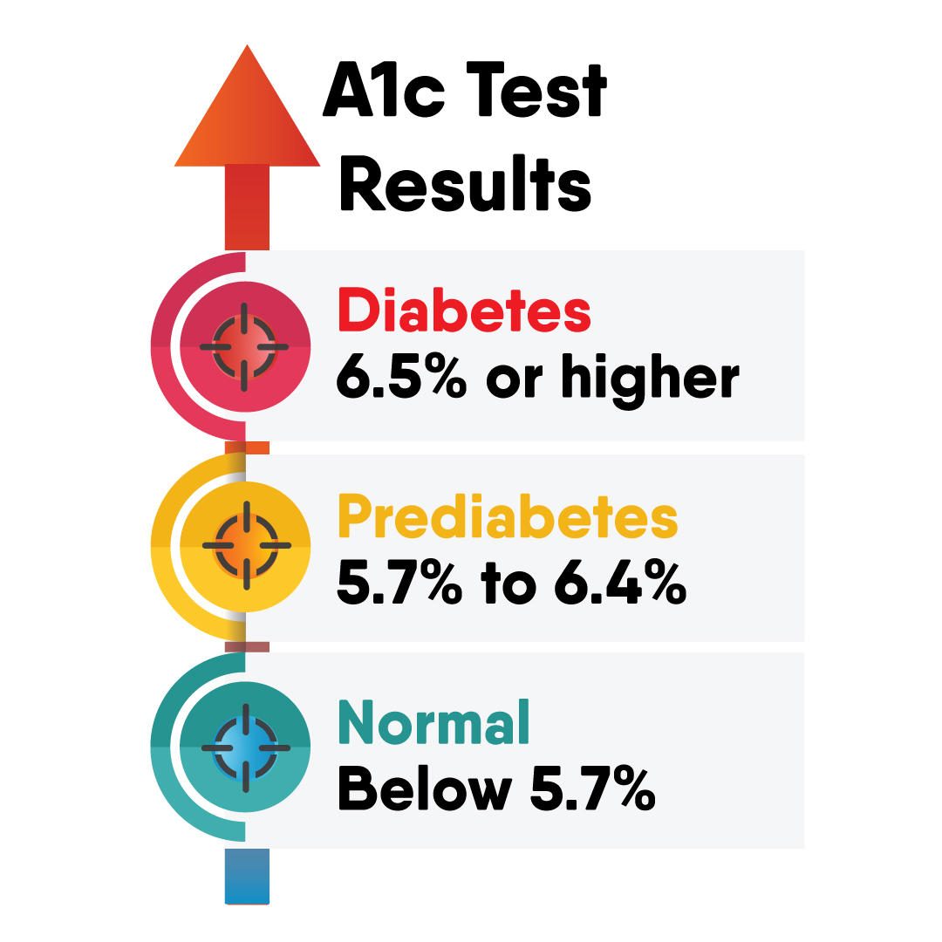
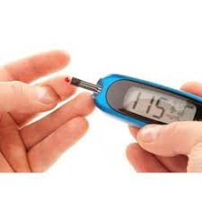
What numbers do I need to know?
A1C is a blood test that help identify and diagnose diabetes.
The higher the number, the higher risk you are for complications. It is measured by percentage.
A1C vs blood sugar reading
Notes:
A1c is actual lab draw. The goal for most adults with diabetes is less than 7%. Blood sugar is test involves poking your finger for a small drop of blood inserted and a number reading is given by the glucometer. A glucometer is given to those who have been diagnosed with diabetes to help monitor their blood sugars. These numbers are important-find out why on the next slides

Slide 4
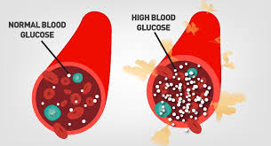
Hyperglycemia
(high blood sugar)
Increased thirst
Blurred vision
Increased urination
Headaches
Dry mouth
Weakness
Nausea
Notes:
Anything higher than 180 is considered high and needs to be treated with insulin. Each dr will have slightly different thoughts on number ranges and what they want an individual to be in. Can lead to DKA-build of acid called ketones-requires hospitalization d/t the emergent nature. Vomiting, dehydration, fruity smelling breath, confusion-worse case coma. Common to be put on an insulin gtt and iv fluids

Slide 5

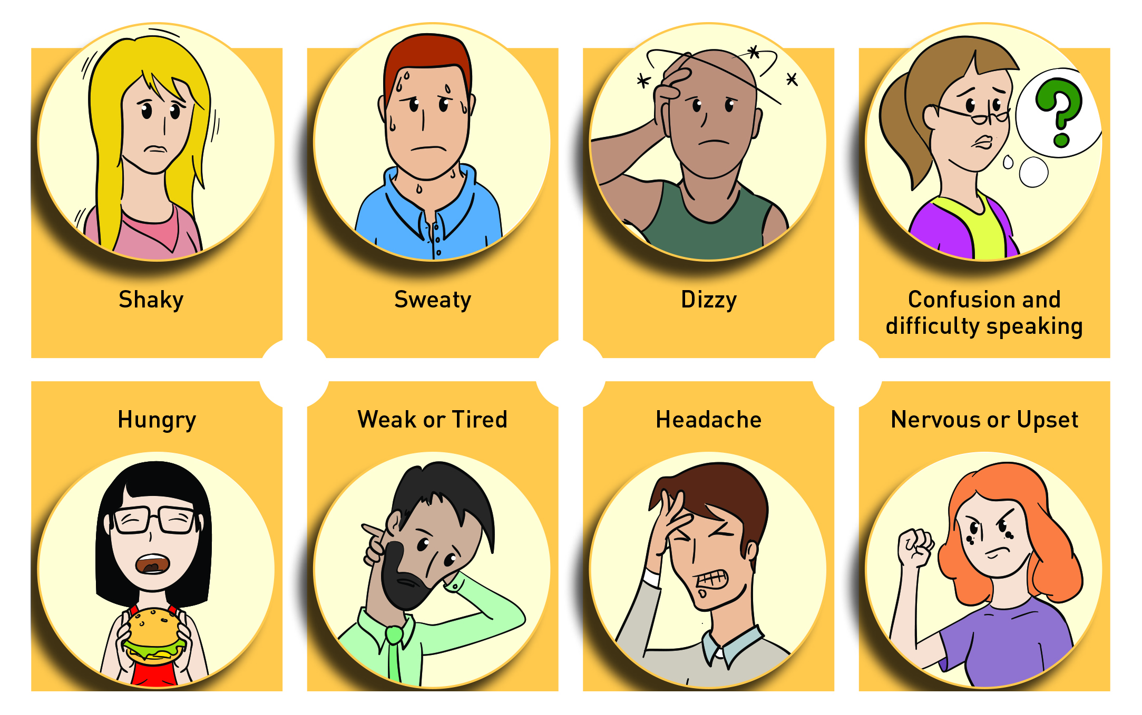
Hypoglycemia (low blood sugar)
C
Notes:
Blood sugar below 70. irritability/anxiety, sweating, shaking- very common. In severe cases- if untreated, people can become unconscious. Treated with sugar- apple juice, long term diabetics usually carry things like glucose tabs, gel . This can happen if not eating enough, taking too much insulin, increase amount of exercise, drinking alcohol(lowers blood sugar)

Slide 6
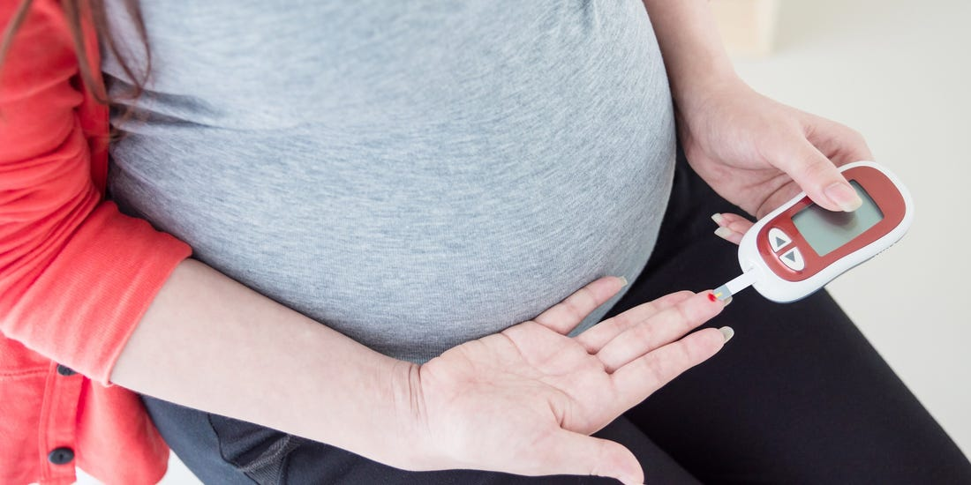
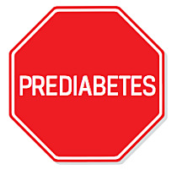
Prediabetes & Gestational
Prediabetes
Gestational
Higher than normal blood sugar or A1C but not high enough to be considered diabetic(type 2)
Changes in diet and activity can keep the blood sugar in check and prevent being diagnosed with diabetes
Having diabetes while pregnant
Diagnosed by completing a glucose challenge test/ glucose tolerance test
Notes:
Pre diabetes- 1 in 3 Americans have prediabetes , 84% don’t know they have it. Refer to the chart on the previous screen-where a1c helps determine. Take this as a warning sign! A chance to do something about it. Gest-happens in about 4% of pregnancies, roughly 50% of those end up developing type 2 afterwards. Glucose test involves the mother drinking a very sugary drink then testing her blood an hr later. If greater than 140, then tolerance test-drinking the liquid, testing blood every hr for 2-3 hrs

Slide 7
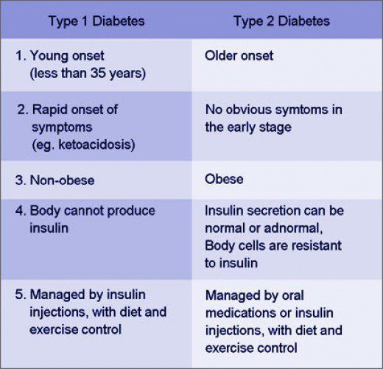
Type 1 vs Type 2
Type 1:
5-10% of people with diabetes have type 1
Type 2:
More likely to develop in those over the age of 45.
Most common type of diabetes
Notes:
Type 1 body attacks itself and the cells that make insulin are harmed. This process can take months to years before any symptoms appear Usually is diagnosed before a person is a teenager but can develop at any age. Body weight is not normally a factor. 2 however, with obesity on the rise in teens and young adults, it is being diagnosed earlier on. Resistance- the body become resistant to insulin and pancrease cannot make enough insulin to overcome this. Can be put into remission- not necesssarly reversed bc uncertain if it can come back

Slide 8
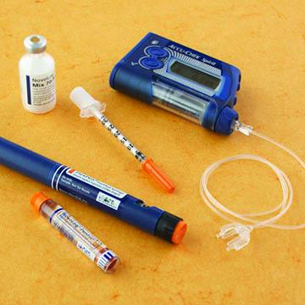
Medications
Insulin:
individual shots
  Pen
  Vial and syringe
insulin pump
Oral/Pills
Notes:
Usually before meal times to count the amount of carbs(being turned into sugar) to account for.There are many different types of insulin-depending on when they peak and how long it works. Type 1 relies on insulin since their body doesn’t make enough(or any) they would be more prone to an insulin pump-gives you a steady programable amount throughout the day. Oral meds-type 2 along with a healthy diet. Type 2 may also need to inject insulin to maintain a healthy blood sugar

Slide 9
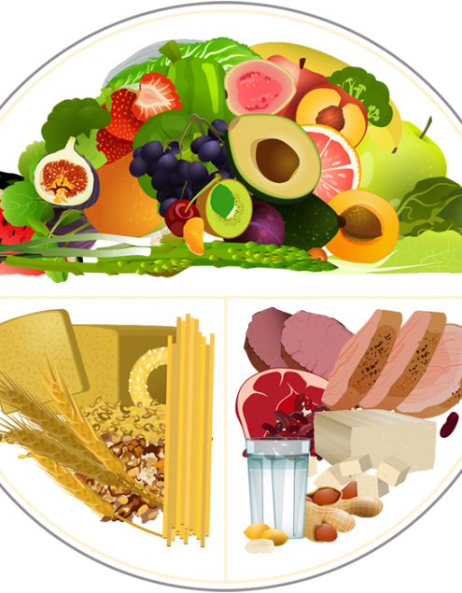
nutrition
C
Learn about carb counting
Read food labels
Limit sweets
Be aware of drinks with added sugar
Choose healthy fats and avoid fried foods
Watch portion sizes
Notes:
Try to limit carbohydrates with added sugars like white bread and white rice, sweets. Instead, eat carbohydrates from fruit, vegetables, whole grains, beans, and low-fat or nonfat milk.
It can be beneficial to meet with a dietitian –help with labels and portion sizes

Slide 10
References
What is Diabetes?. Centers of Disease Control and Prevention. https://www.cdc.gov/diabetes/basics/diabetes.html. Accessed September 15, 2020.
Understanding A1C. American Diabetes Association. https://www.diabetes.org/a1c. Accessed September 14, 2020.
Diabetes Overview. National Institute of Diabetes and Digestive and Kidney Diseases. https://www.niddk.nih.gov/health-information/diabetes/overview/what-is-diabetes. Accessed September 15, 2020.
Diabetic Hypoglycemia. Mayo Clinic. https://www.mayoclinic.org/diseases-conditions/diabetic-hypoglycemia/symptoms-causes/syc-20371525. Accessed September 17, 2020.

Slide 11


Ph: (951) 732-7970 | HealthServices@msjc.edu | www.msjc.edu/healthcenter/
Follow us on Social Media @MSJChealth

