Slide 1


Influenza
Is it a cold or the flu?

Slide 2
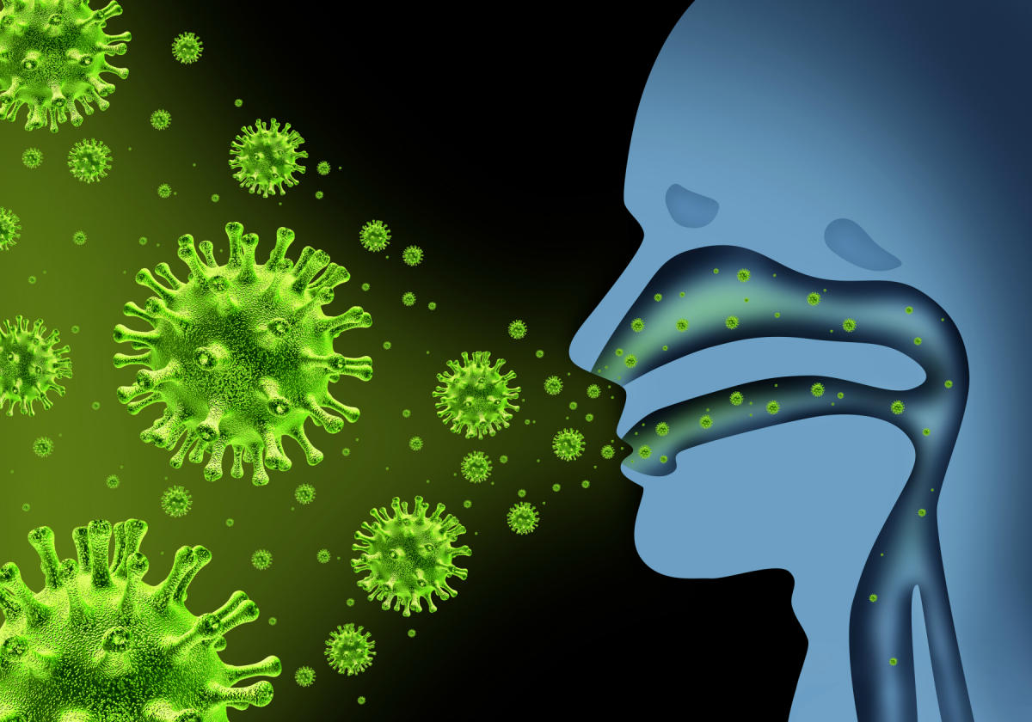
Overview
The flu is a viral infection that attacks the respiratory system.
It travels in the air through droplets caused by coughing, sneezing and talking.
You can inhale the droplets in the air or transfer to your nose, mouth or eyes by touching an object that the germ has contaminated.
You are most contagious 1 day prior to symptoms until about 5 days after the symptoms start.
Notes:
Resp-nose, throat and lungs. Object-door knob.

Slide 3
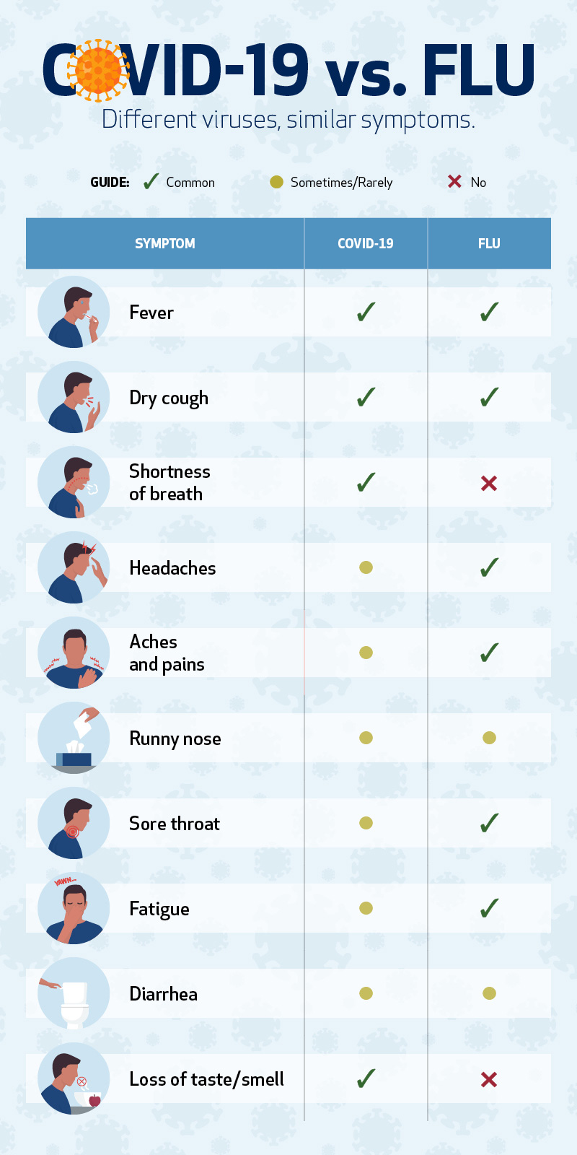
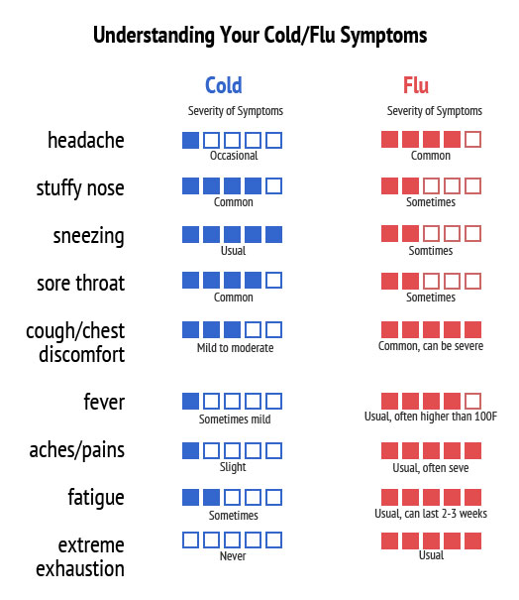
Symptoms
Notes:
A helpful way to remember flu symptoms is the acronym FACTS- fever, aches, chills, tiredness, sudden onset. Runny nose, cough, sore throat. v/d- most common in children * Not everyone with the flu will have a fever!

Slide 4
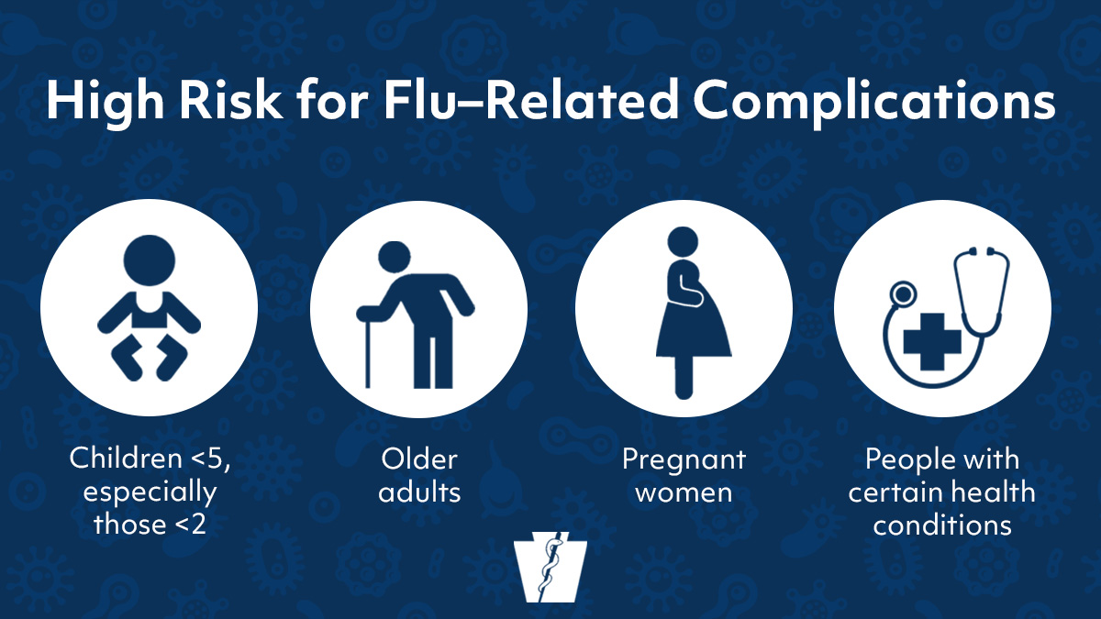
Who's at risk
Complications
Pneumonia
Bronchitis
Asthma flare ups
Ear infections
Acute respiratory distress
Heart problems
Notes:
65 and older, preg and 2 weeks post partum, weakened immune systems and chronic illnesses like asthma, heart disease, dm, kidney and liver disease. Pna-can be very serious esp in older adults

Slide 5

When to see the Dr.
Worsening symptoms of existing medical conditions
If you are at high risk for having complications
More emergent symptoms that may need immediate medical attention are:
  *shortness of breath
  *chest pain
  *dizziness
  *seizures
  You may be given an antiviral medication to take that will help reduce the length of the symptoms and prevent complications like pneumonia.
Notes:
Most commonly you can treat it at home and will recover anywhere from a few days (fever)to a few weeks(fatigue). They work best when given with 48 hours of symptoms starting but can be given any time during the course

Slide 6



Prevention
Not touching your face. Especially if you have not washed your hands.
Get a yearly flu vaccine- the vaccine protects against 3-4 viruses that are expected to be the most common that year.
A nasal spray vaccine is also an option for most
Notes:
The vaccine is for those 6m and older. It can reduce the risk of catching and also the severity if you do get the flu. Ok to get the vaccine even for those with an egg allergy. The nasal spray is not for pregnant women or those with an compromised immune system. Its best to get the vaccine in early fall-ideally before the virus has hit your community

Slide 7
References
Flu (Influenza). National Foundation for Infectious Diseases. https://www.nfid.org/infectious-diseases/influenza-flu/. Accessed November 16,2020.
Influenza (Flu). Mayo Clinic. https://www.mayoclinic.org/diseases-conditions/flu/symptoms-causes/syc-20351719. Accessed November 16,2020.
Influenza(Flu): Flu Symptoms and Complications. Centers for Disease Control and Prevention. https://www.cdc.gov/flu/symptoms/symptoms.htm. Accessed November 17, 2020.

