Slide 1


Strep Throat

Slide 2
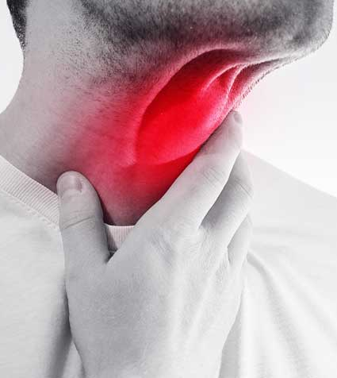
What it is
Strep throat is caused by a bacterial infection- group A Streptococcus.
While anyone can get strep throat, it is most common in children 5-15 years old. However, parents with school aged children or adults around children are at an increased risk.
Spreads from one person to another by droplets in the air (coughing/sneezing), by touching an object then touching your face, or by sharing food/drinks.
1: 10 adults who complain of a sore throat will end up having strep.
Strep can lead to other illnesses like scarlet fever and rhematic fever
Notes:
Most sore throats are caused by a virus(see comparison on next slide). Tends to spread with in a household pretty quickly bc of close contact. And other inflammatory illnesses.

Slide 3
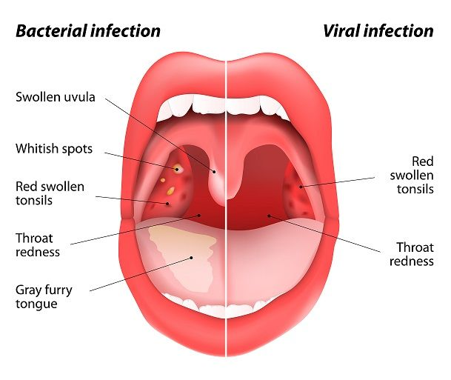
symptoms
Sore throat
Pain with swallowing
Fever/chills
Swollen neck/lymph nodes
Red & swollen tonsils with white patches
Small red dots in back of mouth
Loss of appetite
Rash
Notes:
Sore throat quickly starts Headache/n/v more common in children. Petechiae-tiny red dots.

Slide 4
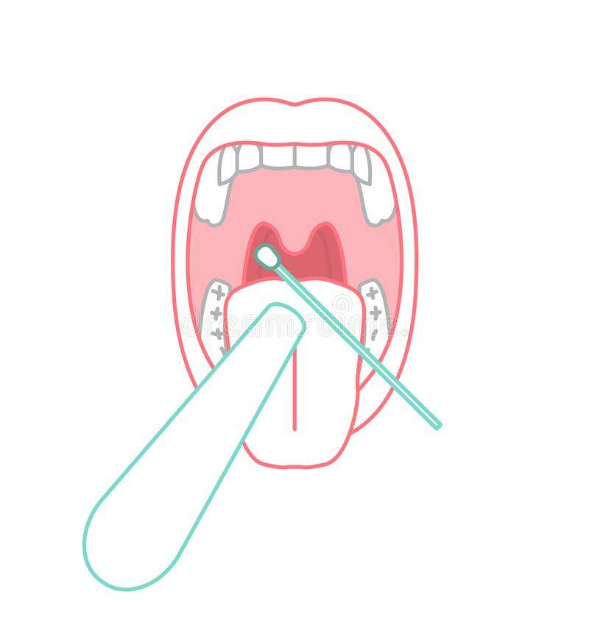
How to test for strep
A swab is wiped against your tonsil and back of throat.
A rapid strep test is first done-results are available in a few minutes.
If that test is negative but your Dr. still suspects that it could be strep, a throat culture can be done. The culture results usually take a few days to come back.
Notes:
A culture can sometimes catch a positive result that the original rapid test missed. This is important esp in children bc it can lead to rhematic fever(not common to do culture in adults bc they don’t tend to get rhematic fever)

Slide 5
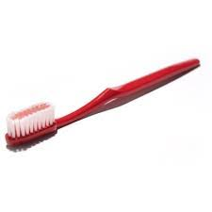
treatment
Antibiotics:
  Avoid contact with other people for at least 24-48 hours and until you know longer have a fever
  Make sure to finish the entire course of antibiotics.
Home Care:
  Drink warm liquids
  Gargle with salt water
  Use throat lozenges
  Try Tylenol or Advil for fever/pain
  Use a humidifier for a dry throat/cough
Stop the spread by changing out your toothbrush after 2-3 days of starting the antibiotics.
Notes:
Either penicillin or amoxicillin are used. A normal course given of antibiotics is 10 days.No longer considered infections. Most people feel better after a week of starting antibiotic treatment. Tips to soothe a sore throat. Tea with honey.

Slide 6
references
Strep Throat: All You Need to Know. Centers for Disease Control and Prevention. https://www.cdc.gov/groupastrep/diseases-public/strep-throat.html. Accessed October 26,2020.
Strep Throat. Mayo Clinic. https://www.mayoclinic.org/diseases-conditions/strep-throat/symptoms-causes/syc-20350338. Accessed October 27,2020.
Strep Throat. Mount Sinai. https://www.mountsinai.org/health-library/diseases-conditions/strep-throat. Accessed October 26,2020.

