Slide 1
Weight Management
Tips to help you be successful with your journey
Notes:
weight management doesnt need to mean weight loss! maybe you just want to maintain! and tweak a few things

Slide 2
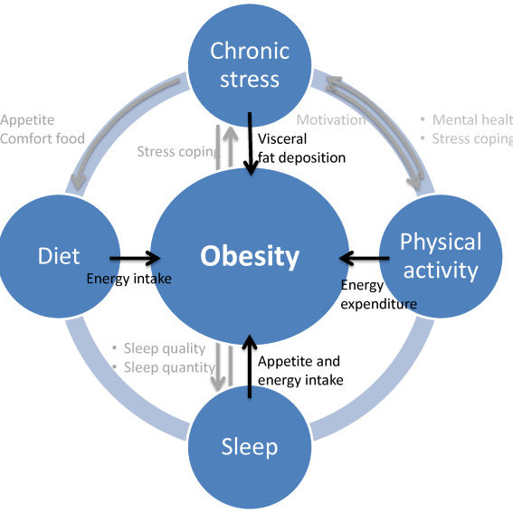
But first, let’s look at factors that contribute to weight gain
Along with those in the diagram, other factors include:
Health history
Medications
Age
Gender/hormones
Notes:
keep these factors in mind as we move on

Slide 3
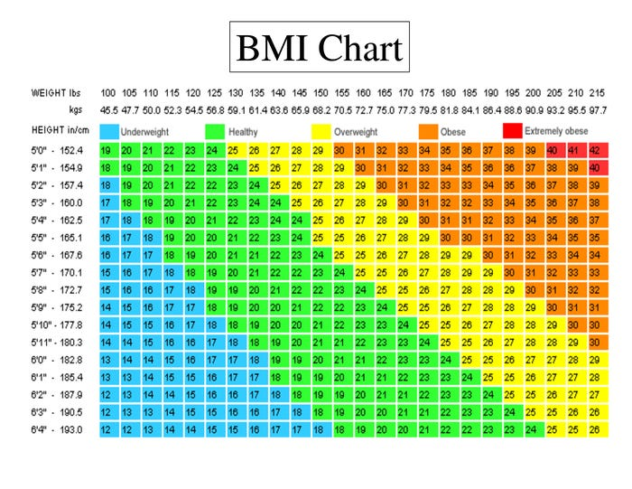
BMI: what is it?
Body mass index (BMI) is a measure of body fat based on height and weight that applies to adults
It will give you a good starting point to assess where you are.
Notes:
this will help gauge where you are. sompe people will fall slightly above or below and that ok!

Slide 4
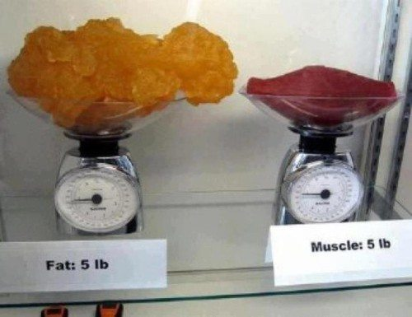
Tips:
500 × 385
For some it helps to not focus on the numbers on the scale-as you gain muscle, you might see an increase or no change in your weight because muscle weighs more than fat
Notes:
its important to customize and find which of these tips work for you

Slide 5
More tips
Count
Count your calories or track your intake. It will make you more aware of what you are putting in your mouth
Think about
Think about your drinks- most have a lot of sugar=wasted calories. Replace these drinks with water!
Stay ahead
Stay ahead of your meals-meal prep so you aren’t eating junk last minute
Portion
Portion control
Don’t skip
Don’t skip breakfast
Get
Get in your servings of fruit and veggies
Start
Start exercising or increase your amount of exercise
Notes:
Increase your water intake

Slide 6
Speaking of fruits and veggies…
Notes:
Its recommended that you get 4-5 servings of fruit and veggies a day

Slide 7
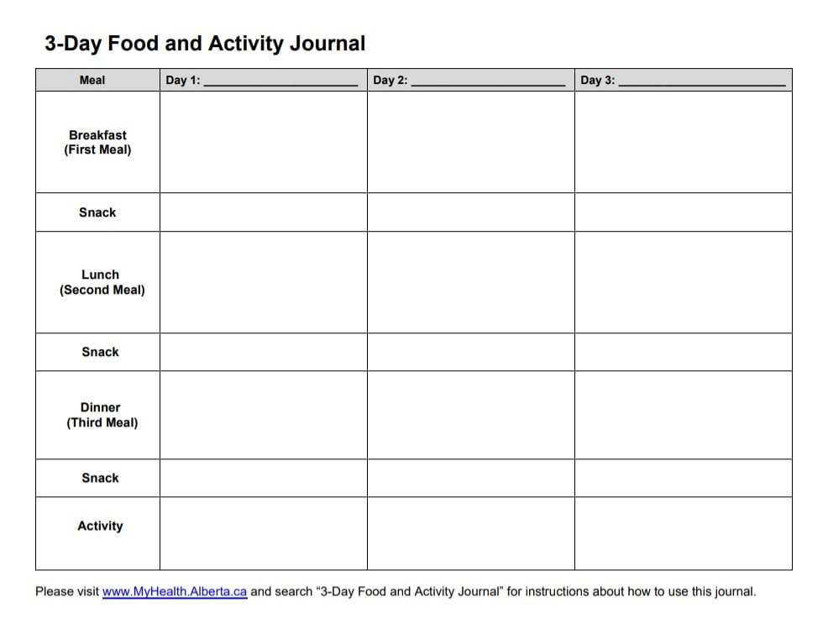
Ways to self monitor
Keep a food and activity log
Notes:
There are so many different food and exercise logs out there. This one incorporates both into one. It will help to hold yourself accountable

Slide 8
Self monitoring continued
Use fitness apps/ aids to count steps
Weight checks- BUT don’t be obsessive about it!
Notes:
Have you heard of Non -scale victories? The scale may not show it but you will notice it in other ways

Slide 9
Phone: (951) 732-7970 | HealthServices@msjc.edu | www.msjc.edu/healthcenter/
Follow us on Social Media @MSJChealth

